Slide 1
Lecture 23. Attention and Transformers

Slide 2
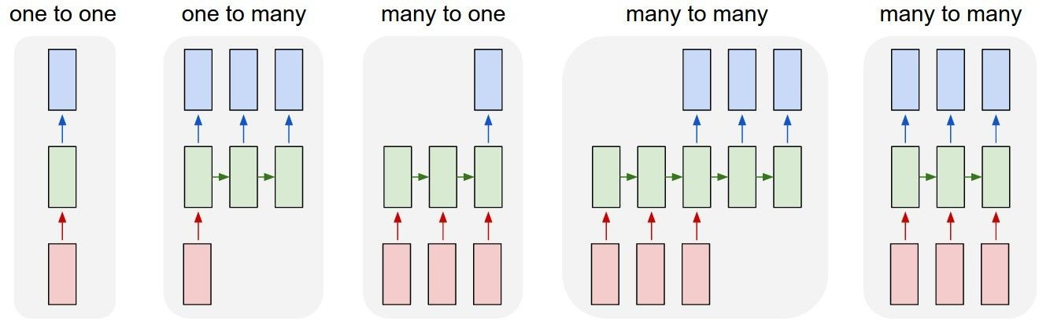
Last Time: Recurrent Neural Networks （循环神经网络）
Vanilla
Neural Networks
e.g. image classification
Notes:
回顾上一节rnn的结构，对于不同的任务有不同的拓扑结构
如
一对一：图片分类
一对多：图片描述
多对一：情绪分类
多对多：序列翻译，视频分类

Slide 3
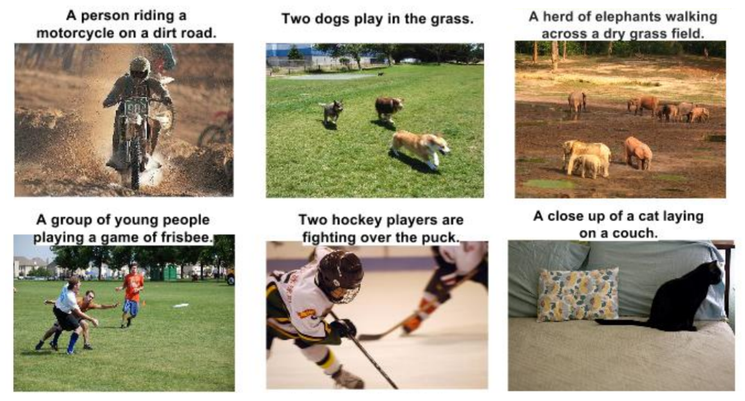
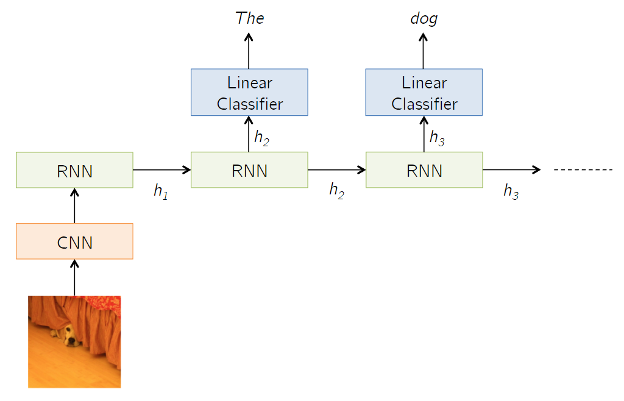
Last Time: Recurrent Neural Networks
e.g. Image Captioning
Image -> sequence of words
Vanilla
Neural Networks
e.g. image classification
Image Captioning
Notes:
回顾上一节rnn的结构，对于不同的任务有不同的拓扑结构
如
一对一：图片分类
一对多：图片描述
多对一：情绪分类
多对多：序列翻译，视频分类

Slide 4
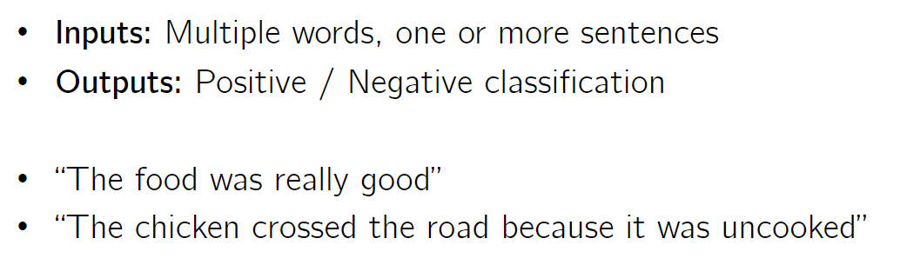
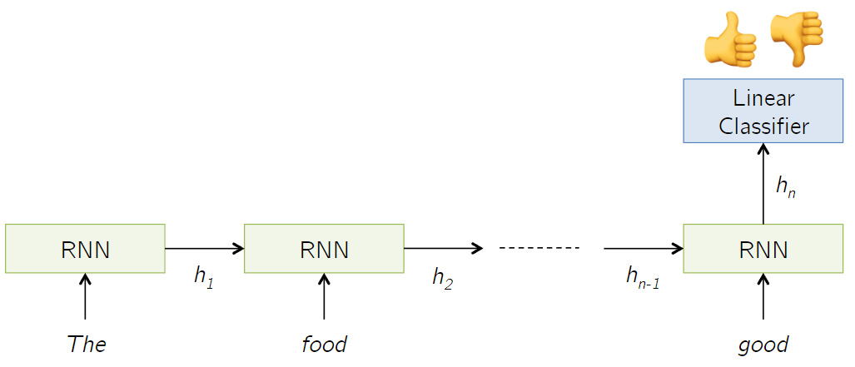
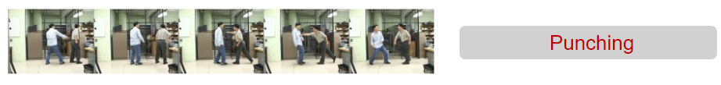
Last Time: Recurrent Neural Networks
e.g. Image Captioning
Image -> sequence of words
Sentiment classification
Video action classification
Vanilla
Neural Networks
e.g. image classification
e.g. Sentiment classification
sequence of words → sentiment
e.g. Video action classification
Notes:
回顾上一节rnn的结构，对于不同的任务有不同的拓扑结构
如
一对一：图片分类
一对多：图片描述
多对一：情绪分类
多对多：序列翻译，视频分类

Slide 5
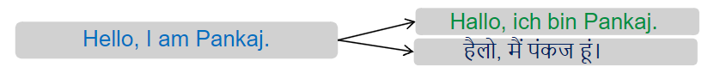
Last Time: Recurrent Neural Networks
e.g. Machine Translation
sequence of words → sequence of words
Input or output: Variable in length
e.g. Image Captioning
Image -> sequence of words
Vanilla
Neural Networks
e.g. image classification
Machine Translation
Notes:
回顾上一节rnn的结构，对于不同的任务有不同的拓扑结构
如
一对一：图片分类
一对多：图片描述
多对一：情绪分类
多对多：序列翻译，视频分类

Slide 6
Last Time: Recurrent Neural Networks
e.g. Machine Translation
sequence of words → sequence of words
Input or output: Variable in length
e.g. Image Captioning
Image -> sequence of words
Vanilla
Neural Networks
e.g. image classification
e.g. Sentiment classification
sequence of words → sentiment
e.g. Video action classification
e.g. Video classification on frame level
Notes:
回顾上一节rnn的结构，对于不同的任务有不同的拓扑结构
如
一对一：图片分类
一对多：图片描述
多对一：情绪分类
多对多：序列翻译，视频分类

Slide 7

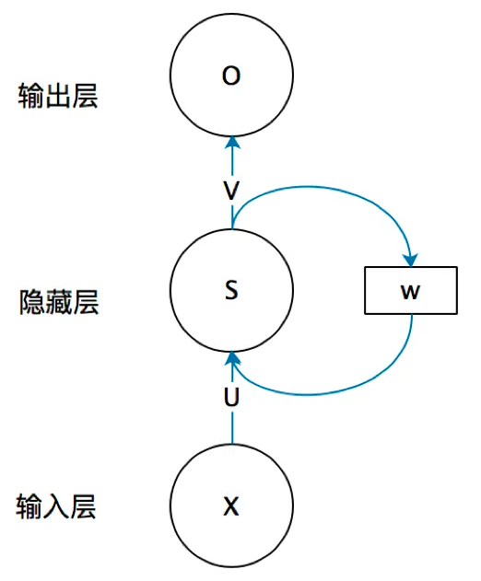
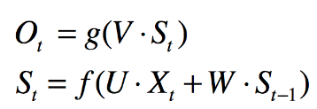
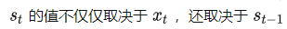
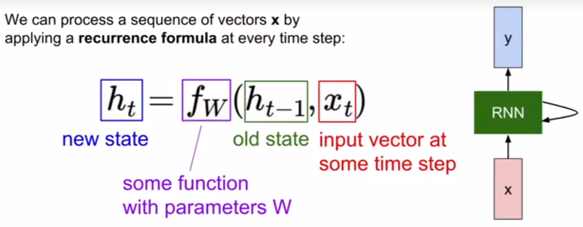
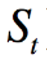
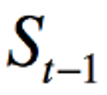
Last Time: Recurrent Neural Networks
按照时间线展开

Slide 8
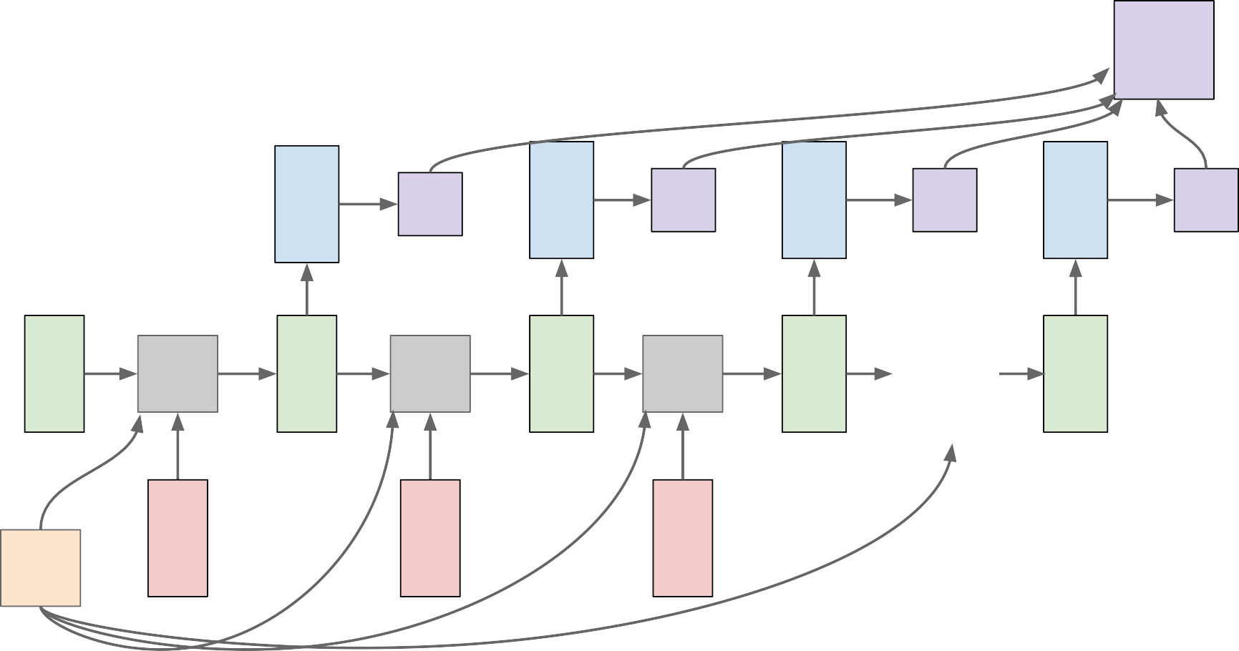
Variable length computation graph with shared weights
L
f_{W} | y₁ h₁ | L₁ f_{W} | y₂ h₂ | L₂ f_{W} | y₃ h₃ | L₃ … | y_{T} h_{T} | L_{T}
x₁ |  | x₂ |  | x₃
h₀
W
shared
Notes:
主要想说明rnn共享权重的特性

Slide 9
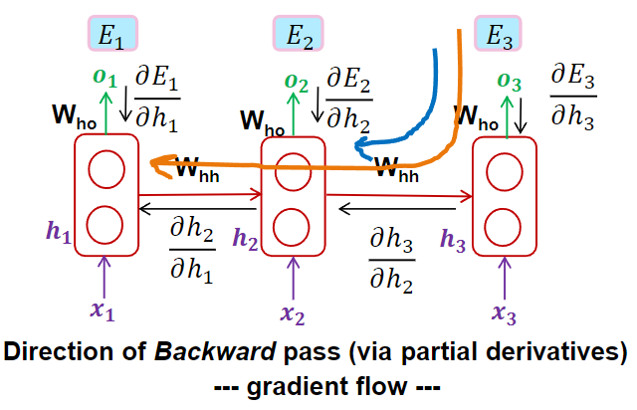
Last Time: Recurrent Neural Networks
Training recurrent networks via Backpropogation through time (BPTT)

Slide 10
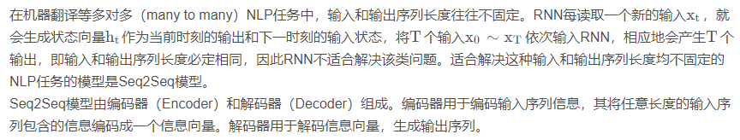
Last Time: Sequence to Sequence (Seq2Seq)
Decoder
Encoder
bidirectional RNN 双向循环网络
RNN
Long short-term memory (LSTM)
Notes:
回顾上一节rnn的结构，对于不同的任务有不同的拓扑结构
如
一对一：图片分类
一对多：图片描述
多对一：情绪分类
多对多：序列翻译，视频分类

Slide 11
Sequence to Sequence with RNNs
Input: Sequence x₁, … x_{T}
Output: Sequence y₁, …, y_{T’}
Encoder: h_{t} = f_{W}(x_{t}, h_{t-1})
Encoder: h_{t} = f_{W}(x_{t}, h_{t-1})
h₁
h₂
h₃
h₄
x₁
x₂
x₃
x₄
we
are
eating
bread
Notes:
首先介绍seq2seq模型（基于rnn
序列翻译模型主要由encoder和decoder两部分组成，输入输出都是不定长的序列。
输入序列按timestep依次输入网络

Slide 12
Sequence to Sequence with RNNs
Input: Sequence x₁, … x_{T}
Output: Sequence y₁, …, y_{T’}
From final hidden state predict:
Initial decoder state s
Encoder: h_{t} = f_{W}(x_{t}, h_{t-1})
0
Context vector c (often c=h_{T})
h₁
h₂
h₃
h₄
s₀
x₁
x₂
x₃
x₄
c
we
are
eating
bread
Notes:
Encoder依次对输入进行编码，结合历史信息输出相应的隐藏状态，最终输出的隐藏状态作为整个句子的表征，通常context为最后一步的隐藏状态。

Slide 13
Sequence to Sequence with RNNs
Decoder解码Encoder生成的信息向量，生成输出序列。Decoder是一个RNN，其初始状态不是全0向量，而是Encoder的最后一个状态。
Input: Sequence x₁, … x_{T}
Output: Sequence y₁, …, y_{T’}
Decoder: s_{t} = g_{U}(y_{t-1}, s_{t-1}, c)
estamos
From final hidden state predict:
Initial decoder state s
y₁
Encoder: h_{t} = f_{W}(x_{t}, h_{t-1})
0
Context vector c (often c=h_{T})
h₁
h₂
h₃
h₄
s₀
s₁
x₁
x₂
x₃
x₄
c
y₀
we
are
eating
bread
[START]
起始符
Notes:
decoder在各个时间步中使用输⼊句子的表征和上个时间步的输出以及隐藏状态作为输⼊，然后依次翻译出相应的输出向量。

Slide 14
Sequence to Sequence with RNNs
Input: Sequence x₁, … x_{T}
Output: Sequence y₁, …, y_{T’}
Decoder: s_{t} = g_{U}(y_{t-1}, s_{t-1}, c)
estamos
comiendo
From final hidden state predict:
Initial decoder state s
y₁
y₂
Encoder: h_{t} = f_{W}(x_{t}, h_{t-1})
0
Context vector c (often c=h_{T})
h₁
h₂
h₃
h₄
s₀
s₁
s₂
x₁
x₂
x₃
x₄
c
y₀
y₁
we
are
eating
bread
[START] estamos
Notes:
重复这个步骤就可以得到翻译序列

Slide 15
Sequence to Sequence with RNNs
Input: Sequence x₁, … x_{T}
Output: Sequence y₁, …, y_{T’}
Decoder: s_{t} = g_{U}(y_{t-1}, s_{t-1}, c)
停止符
estamos
comiendo
pan
[STOP]
From final hidden state predict:
Initial decoder state s
y₁
y₂
y₃
y₄
Encoder: h_{t} = f_{W}(x_{t}, h_{t-1})
0
Context vector c (often c=h_{T})
h₁
h₂
h₃
h₄
s₀
s₁
s₂
s₃
s₄
x₁
x₂
x₃
x₄
c
y₀
y₁
y₂
y₃
we
are
eating
bread
[START] estamos comiendo pan

Slide 16
Sequence to Sequence with RNNs
1. Linear interaction distance。很难捕获长距依赖（RNN在长序列中有梯度爆炸和消失问题）
2. Lack of parallelizability。不能够并行化
RNN存在问题：
Input: Sequence x₁, … x_{T}
Output: Sequence y₁, …, y_{T’}
Decoder: s_{t} = g_{U}(y_{t-1}, s_{t-1}, c)
estamos
comiendo
pan
[STOP]
From final hidden state predict:
Initial decoder state s
y₁
y₂
y₃
y₄
Encoder: h_{t} = f_{W}(x_{t}, h_{t-1})
0
Context vector c (often c=h_{T})
h₁
h₂
h₃
h₄
s₀
s₁
s₂
s₃
s₄
x₁
x₂
x₃
x₄
c
y₀
y₁
y₂
y₃
we
are
eating
bread
Problem: Input sequence bottlenecked through fixed-sized vector. What if T=1000?
[START] estamos comiendo pan
Encoder最后一个状态是整个输入序列的概要，即对输入序列的编码
Notes:
经过上述示例，不难注意到：
编码器要将整个序列的信息压缩进一个固定长度的向量中去。当序列长度不太长时，这么做是可行的。
但是这样做有两个弊端，一是上下文向量C无法完全表示整个序列的信息，二是先输入的内容携带的信息会被后输入的信息稀释掉。
Seq2seq模型基于这样的假设，即相邻的词之间存在较为密切的关系，然而当存在长句时（包含较长的从句），语义相邻的词由于距离的关系梯度衰减甚至消失会导致丧失这种联系，因此导致损失信息。
这里抛出红字部分的问题：输入的瓶颈在于编码向量长度，定长的编码向量只能存储有限的信息，同时由于更新策略的问题，如果句子太长（甚至长于编码向量维度本身）会存在编码信息损失的问题。

Slide 17
Sequence to Sequence with RNNs
Input: Sequence x₁, … x_{T}
Output: Sequence y₁, …, y_{T’}
Decoder: s_{t} = g_{U}(y_{t-1}, s_{t-1}, c)
estamos
comiendo
pan
[STOP]
From final hidden state predict:
Initial decoder state s
y₁
y₂
y₃
y₄
Encoder: h_{t} = f_{W}(x_{t}, h_{t-1})
0
Context vector c (often c=h_{T})
h₁
h₂
h₃
h₄
s₀
s₁
s₂
s₃
s₄
x₁
x₂
x₃
x₄
c
y₀
y₁
y₂
y₃
we
are
eating
bread
Problem: Input sequence bottlenecked through fixed-sized vector. What if T=1000?
[START] estamos comiendo pan
Idea: use new context vector at each step of decoder!
Notes:
想法：为了避免太长的句子导致编码信息丢失，同时避免这种长句中实际相隔较远但语义上相邻词的关系被长距离淹没，我们需要设计更好的context来表征不同word之间的联系。（attention机制

Slide 18
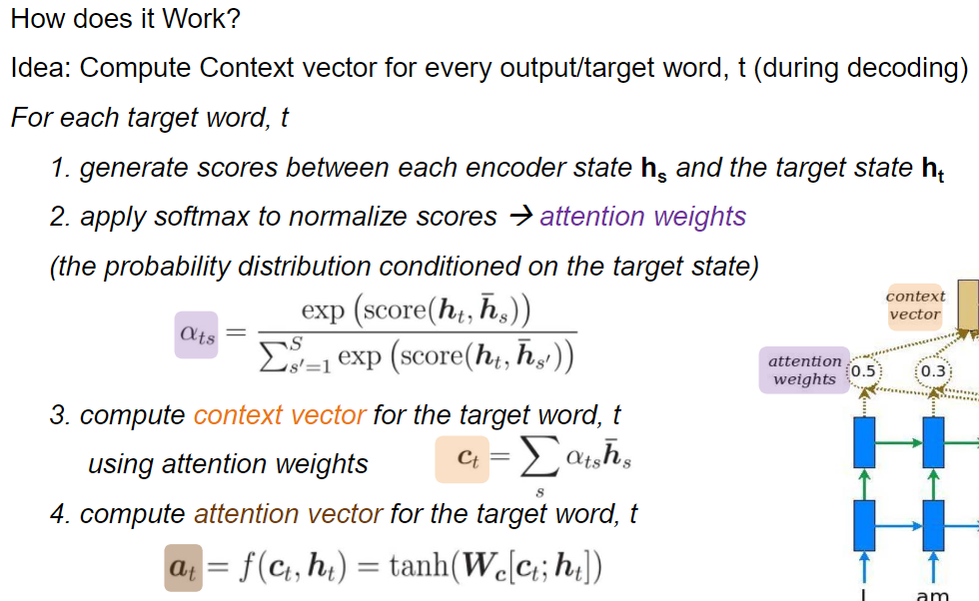
Sequence to Sequence with RNNs and Attention
Attention Mechanism
Notes:
这里与6一致。

Slide 19
Sequence to Sequence with RNNs and Attention
Input: Sequence x₁, … x_{T}
Output: Sequence y₁, …, y_{T’}
Encoder: h = f (x , h )
From final hidden state:
Initial decoder state s₀
t
W t t-1
h₁
h₂
h₃
h₄
s₀
x₁
x₂
x₃
x₄
we
are
eating
bread
Notes:
这里与6一致。

Slide 20
Sequence to Sequence with RNNs and Attention
设计每次只关注和自己最相关的几个隐状态的context，每次只编码少数几个隐状态，这样就避免了信息在传递中损失
Compute (scalar) alignment scores
^{e}t,i ^{= f}att^{(s}t-1^{, h}i⁾
(f_{att} is an MLP)
From final hidden state:
Initial decoder state s₀
^{e}11
^{e}12
^{e}13
^{e}14
h₁
h₂
h₃
h₄
s₀
x₁
x₂
x₃
x₄
we
are
eating
bread
Notes:
设计每次只关注和自己最相关的几个隐状态的context，每次只编码少数几个隐状态，这样就避免了信息在传递中损失
具体做法是，计算序列表征s0与各个隐状态ht的投影（相当于得到不同隐状态ht对当前序列表征s0的贡献度），反映出当前表征下序列中我们关心的部分。

Slide 21
Sequence to Sequence with RNNs and Attention
Compute (scalar) alignment scores
ª11
ª12
ª13
ª14
^{e}t,i ^{= f}att^{(s}t-1^{, h}i⁾
(f_{att} is an MLP)
softmax
Normalize alignment scores to get attention weights
0 < a_{t,i} < 1 ∑_{i}a_{t,i} = 1
From final hidden state: Initial decoder
^{e}11
^{e}12
^{e}13
^{e}14
state s₀
h₁
h₂
h₃
h₄
s₀
x₁
x₂
x₃
x₄
we
are
eating
bread
Notes:
用softmax进行归一化输出贡献权重，满足和为1

Slide 22

Sequence to Sequence with RNNs and Attention
Compute (scalar) alignment scores
^{e}t,i ^{= f}att^{(s}t-1^{, h}i⁾
(f_{att} is an MLP)
ª11
ª12
ª13
ª14
estamos
Normalize alignment scores to get attention weights
0 < a_{t,i} < 1 ∑_{i}a_{t,i} = 1
Compute context vector as linear combination of hidden states
^{c}t ^{= ∑}iªt,i^{h}i
softmax
y₁
From final hidden state:
Initial decoder state s
^{e}11
^{e}12
^{e}13
^{e}14
0
h₁
+
s₁
h₂
h₃
h₄
s₀
x₁
x₂
x₃
x₄
c₁
y₀
we
are
eating
bread
[START]
根据贡献加权求和h_{t}得到当前的context特征c₁，这样就得到了在此时最关注的部分输入
Notes:
根据贡献加权求和ht得到当前的context特征c1，这样就得到了在此时最关注的部分输入

Slide 23
Sequence to Sequence with RNNs and Attention
Compute (scalar) alignment scores
^{e}t,i ^{= f}att^{(s}t-1^{, h}i⁾
(f_{att} is an MLP)
ª11
ª12
ª13
ª14
estamos
Normalize alignment scores to get attention weights
0 < a_{t,i} < 1 ∑_{i}a_{t,i} = 1
Compute context vector as linear combination of hidden states
^{c}t ^{= ∑}iªt,i^{h}i
Use context vector in decoder: s_{t} = g_{U}(y_{t-1}, s_{t-1}, c_{t})
softmax
y₁
From final hidden state:
Initial decoder state s
^{e}11
^{e}12
^{e}13
^{e}14
0
h₁
+
s₁
h₂
h₃
h₄
s₀
Intuition: Context vector attends to the
x₁
x₂
x₃
x₄
relevant part of the input
sequence
“estamos” = “we are” so maybe a₁₁=a₁₂=0.45, a₁₃=a₁₄=0.05
c₁
y₀
we
are
eating
bread
[START]
Notes:
这里举了个例子，翻译“estamos” = “we are” 的时候，直观上we和are对应的隐状态对于“estamos”的贡献应当是相同的。

Slide 24
Sequence to Sequence with RNNs and Attention
Compute (scalar) alignment scores
^{e}t,i ^{= f}att^{(s}t-1^{, h}i⁾
(f_{att} is an MLP)
ª11
ª12
ª13
ª14
estamos
Normalize alignment scores to get attention weights
0 < a_{t,i} < 1 ∑_{i}a_{t,i} = 1
Compute context vector as linear combination of hidden states
^{c}t ^{= ∑}iªt,i^{h}i
Use context vector in decoder: s_{t} = g_{U}(y_{t-1}, s_{t-1}, c_{t})
softmax
y₁
From final hidden state:
Initial decoder state s
^{e}11
^{e}12
^{e}13
^{e}14
0
h₁
+
s₁
h₂
h₃
h₄
s₀
Intuition: Context vector attends to the
x₁
x₂
x₃
x₄
relevant part of the input
sequence
“estamos” = “we are” so maybe a₁₁=a₁₂=0.45, a₁₃=a₁₄=0.05
c₁
y₀
we
are
eating
bread
[START]
This is all differentiable! No supervision on attention weights – backprop through everything
Notes:
这样使用MLP得到权重再加权求和context的操作当然是可微的，梯度反向传播能自己学到这些注意力权重，因此我们不需要任何的额外操作

Slide 25
Sequence to Sequence with RNNs and Attention
context由上一步输出的s1隐状态在ht上求解的权重再对ht加权求和得到的c2替代
^{c}t ^{= ∑}iªt,i^{h}i
Repeat: Use s₁ to compute new context vector c₂
ª21
ª22
ª23
ª24
estamos
softmax
y₁
^{e}21
^{e}22
^{e}23
^{e}24
+
h₁
h₂
h₃
h₄
s₁
s₀
x₁
x₂
x₃
x₄
c₁
y₀
c₂
we
are
eating
bread
[START]
Notes:
与前述的decoder操作一致，只是这时的context由上一步输出的s1隐状态在ht上求解的权重再对ht加权求和得到的c2替代，即这时的context是动态生成的，并且每一次都在输入序列的所有词信息中寻找与下一步输出相关的部分，也就是attention

Slide 26
Sequence to Sequence with RNNs and Attention
Repeat: Use s₁ to compute new context vector c₂
ª21
ª22
ª23
ª24
estamos
comiendo
softmax
y₁
y₂
^{e}21
^{e}22
^{e}23
^{e}24
+
Use c₂ to compute s₂, y₂
h₁
h₂
h₃
h₄
s₁
s₂
s₀
x₁
x₂
x₃
x₄
c₁
y₀
c₂
y₁
we
are
eating
bread
[START]
estamos
Notes:
重复上面的步骤

Slide 27
Sequence to Sequence with RNNs and Attention
Repeat: Use s₁ to compute new context vector c₂
ª21
ª22
ª23
ª24
estamos
comiendo
softmax
y₁
y₂
^{e}21
^{e}22
^{e}23
^{e}24
+
Use c₂ to compute s₂, y₂
h₁
h₂
h₃
h₄
s₁
s₂
s₀
Intuition: Context vector attends to the relevant part of the input sequence
“comiendo” = “eating” so maybe a₂₁=a₂₄=0.05, a₂₂=0.1, a₂₃=0.8
x₁
x₂
x₃
x₄
c₁
y₀
c₂
y₁
we
are
eating
bread
[START]
estamos
Notes:
同样的例子

Slide 28
Sequence to Sequence with RNNs and Attention
Use a different context vector in each timestep of decoder
Input sequence not bottlenecked through single vector
At each timestep of decoder, context vector “looks at” different parts of the input sequence
estamos
comiendo
pan
[STOP]
y₁
y₂
y₃
y₄
Attention
h₁
h₂
h₃
h₄
s₀
s₁
s₂
s₃
s₄
x₁
x₂
x₃
x₄
c₁
y₀
c₂
y₁
c₃
y₂
c₄
y₃
we
are
eating
bread
[START]
estamos
comiendo
pan
Notes:
在不同的时间步中使用不同的context信息，根据上一个词及其隐状态判断此时应该关注输入序列的哪个部分，从而生成相应的输出和隐状态。由于context是动态调整的，每一次都可以“看到”整个输入并从中找到有用的部分，因此序列长度可以不受单个context的表征能力限制

Slide 29
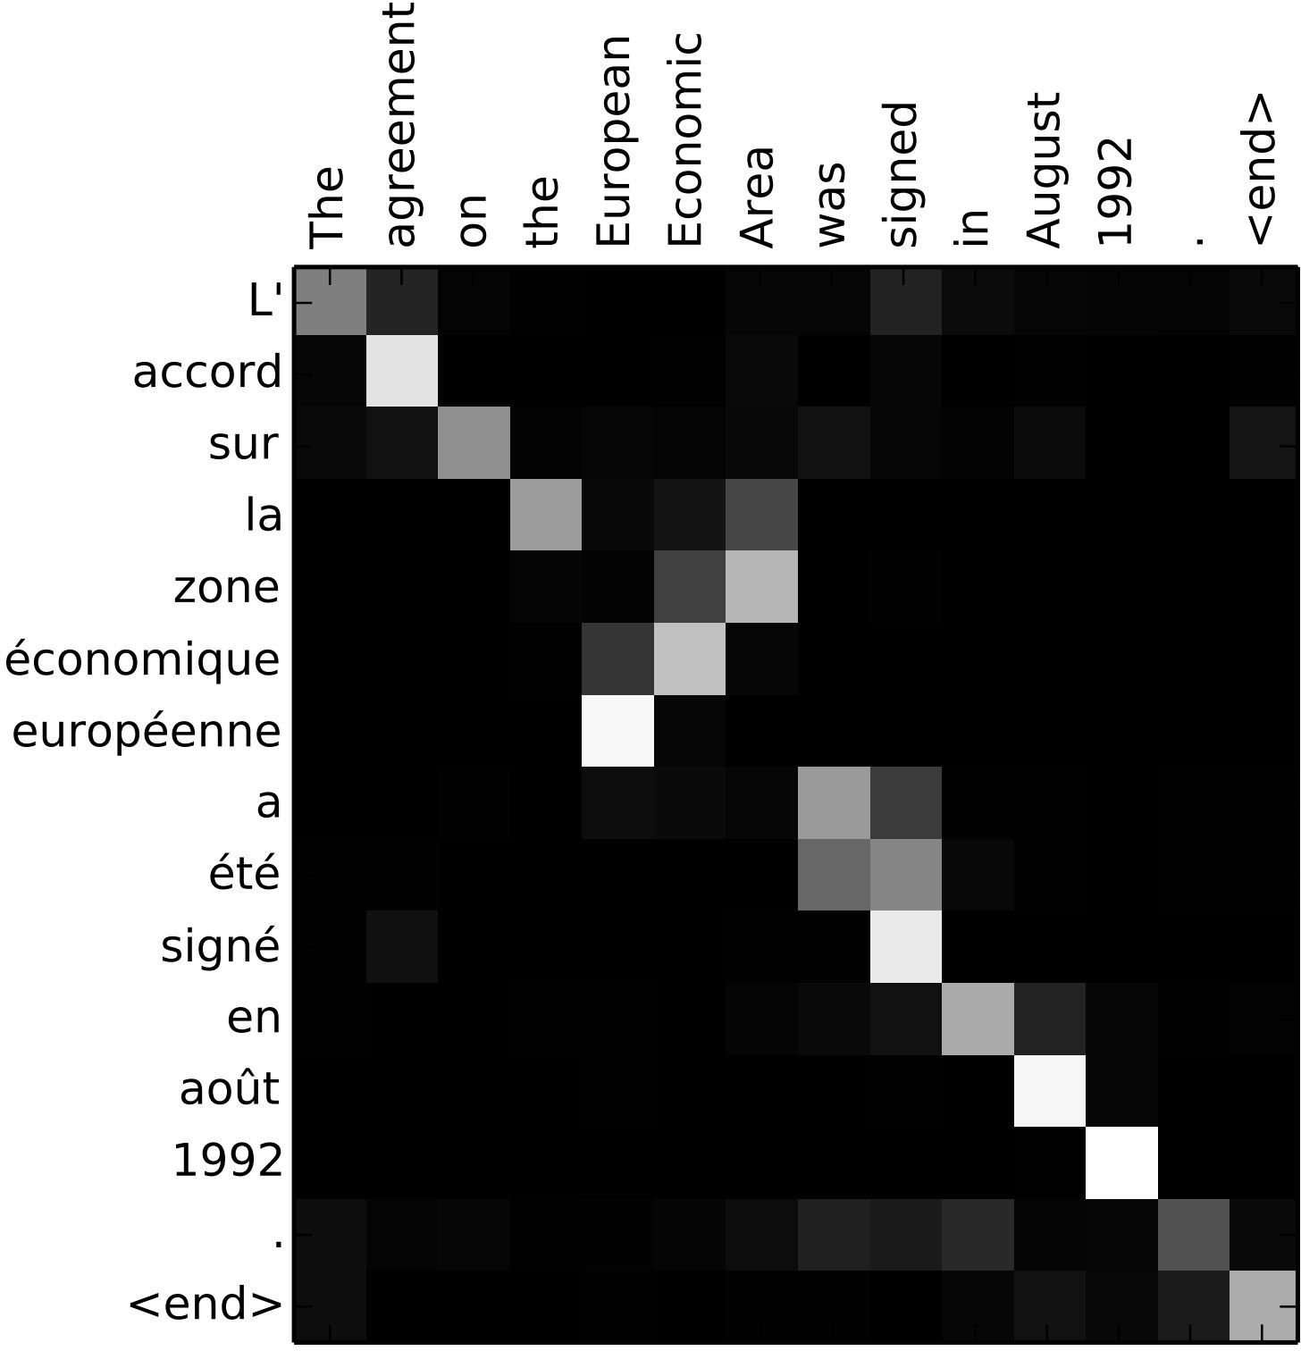
Sequence to Sequence with RNNs and Attention
Visualize attention weights a_{t,i}
Example: English to French translation
Input: “The agreement on the European Economic Area was signed in August 1992.”
Output: “L’accord sur la zone économique européenne a été signé en août 1992.”
Notes:
一个示例，展现了输入输出序列单词之间对应的attention权重图

Slide 30
Sequence to Sequence with RNNs and Attention
Visualize attention weights a_{t,i}
Example: English to French translation
Input: “The agreement on the European Economic Area was signed in August 1992.”
Diagonal attention means words correspond in order
Output: “L’accord sur la zone économique européenne a été signé en août 1992.”
Diagonal attention means words correspond in order
Notes:
单词按照语序一一对应，可以直观看出这不仅是合理的，而且符合直觉

Slide 31
Sequence to Sequence with RNNs and Attention
Visualize attention weights a_{t,i}
Example: English to French translation
Input: “The agreement on the European Economic Area was signed in August 1992.”
Diagonal attention means words correspond in order
Attention figures out different word orders
Output: “L’accord sur la zone économique européenne a été signé en août 1992.”
Diagonal attention means words correspond in order
Notes:
这里的红色部分是由于英语和法语不同的表达习惯带来的区别。后面的动词部分也很好的关联到了一起

Slide 32
Sequence to Sequence with RNNs and Attention
The decoder doesn’t use the fact that h_{i} form an ordered sequence – it just treats them as an unordered set {h_{i}}
Can use similar architecture given any set of input hidden vectors {h_{i}}!
estamos
comiendo
pan
[STOP]
y₁
y₂
y₃
y₄
Attention
h₁
h₂
h₃
h₄
s₀
s₁
s₂
s₃
s₄
x₁
x₂
x₃
x₄
c₁
y₀
c₂
y₁
c₃
y₂
c₄
y₃
we
are
eating
bread
[START]
estamos
comiendo
pan
Notes:
这里可以看出attention操作的一个特点，无序，换言之，attention的感受野是全局的，隐状态的次序并不影响输出。
也就是说，attention的权重仅取决于当前的查询（即上一个隐状态s）与key的相关性

Slide 33

Image Captioning using spatial features
Input: Image I
Output: Sequence y = y , y ,..., y
1 2
T
^{z}0,0 | ^{z}0,1 | ^{z}0,2
^{z}1,0 | ^{z}1,1 | ^{z}1,2
^{z}2,0 | ^{z}2,1 | ^{z}2,2
CNN
Extract spatial features from a pretrained CNN
Features: H x W x D
Notes:
下面来看另一个任务，图像描述。目标是得到关于一张图片的描述，image2seq任务。

Slide 34
Image Captioning using spatial features
Input: Image I
Output: Sequence y = y , y ,..., y
1 2
T
Encoder: h₀ = f_{W}(z)
where z is spatial CNN features f_{W}(.) is an MLP
^{z}0,0 | ^{z}0,1 | ^{z}0,2
^{z}1,0 | ^{z}1,1 | ^{z}1,2 | MLP
^{z}2,0 | ^{z}2,1 | ^{z}2,2
h₀
CNN
Extract spatial features from a pretrained CNN
Features: H x W x D
Notes:
首先MLP将特征图映射到表征向量

Slide 35
Image Captioning using spatial features
Input: Image I
Output: Sequence y = y , y ,..., y
Decoder: y_{t} = g_{V}(y_{t-1}, h_{t-1}, c)
where context vector c is often c = h₀
1 2
T
Encoder: h₀ = f_{W}(z)
where z is spatial CNN features f_{W}(.) is an MLP
person
y₁
^{z}0,0 | ^{z}0,1 | ^{z}0,2
^{z}1,0 | ^{z}1,1 | ^{z}1,2 | MLP
^{z}2,0 | ^{z}2,1 | ^{z}2,2
h₀
h₁
CNN
Extract spatial features from a pretrained CNN
Features: H x W x D
c
y
0
Notes:
然后就与上述seq2seq的decoder操作一致

Slide 36
Image Captioning using spatial features
Input: Image I
Output: Sequence y = y , y ,..., y
Decoder: y_{t} = g_{V}(y_{t-1}, h_{t-1}, c)
where context vector c is often c = h₀
1 2
T
Encoder: h₀ = f_{W}(z)
where z is spatial CNN features f_{W}(.) is an MLP
person
wearing
y₁
y₂
^{z}0,0 | ^{z}0,1 | ^{z}0,2
^{z}1,0 | ^{z}1,1 | ^{z}1,2 | MLP
^{z}2,0 | ^{z}2,1 | ^{z}2,2
h₀
h₁
h₂
CNN
Extract spatial features from a pretrained CNN
Features: H x W x D
c
y
y
0
1

Slide 37
Image Captioning using spatial features
Input: Image I
Output: Sequence y = y , y ,..., y
Decoder: y_{t} = g_{V}(y_{t-1}, h_{t-1}, c)
where context vector c is often c = h₀
1 2
T
Encoder: h₀ = f_{W}(z)
where z is spatial CNN features f_{W}(.) is an MLP
person
wearing
hat
y₁
y₂
y₃
^{z}0,0 | ^{z}0,1 | ^{z}0,2
^{z}1,0 | ^{z}1,1 | ^{z}1,2 | MLP
^{z}2,0 | ^{z}2,1 | ^{z}2,2
h₀
h₁
h₂
h₃
CNN
Extract spatial features from a pretrained CNN
Features: H x W x D
c
y
y
y
0
1
2

Slide 38
Image Captioning using spatial features
Input: Image I
Output: Sequence y = y , y ,..., y
Decoder: y_{t} = g_{V}(y_{t-1}, h_{t-1}, c)
where context vector c is often c = h₀
1 2
T
Encoder: h₀ = f_{W}(z)
where z is spatial CNN features f_{W}(.) is an MLP
person
wearing
hat
[END]
y₁
y₂
y₃
y₄
^{z}0,0 | ^{z}0,1 | ^{z}0,2
^{z}1,0 | ^{z}1,1 | ^{z}1,2 | MLP
^{z}2,0 | ^{z}2,1 | ^{z}2,2
h₀
h₁
h₂
h₃
h₄
CNN
Extract spatial features from a pretrained CNN
Features: H x W x D
c
y
y
y
y
0
1
2
3

Slide 39
Image Captioning using spatial features
Problem: Input is "bottlenecked" through c
- Model needs to encode everything it wants to say within c
This is a problem if we want to generate really long descriptions? 100s of words long
person
wearing
hat
[END]
y₁
y₂
y₃
y₄
^{z}0,0 | ^{z}0,1 | ^{z}0,2
^{z}1,0 | ^{z}1,1 | ^{z}1,2 | MLP
^{z}2,0 | ^{z}2,1 | ^{z}2,2
h₀
h₁
h₂
h₃
h₄
CNN
Extract spatial features from a pretrained CNN
Features: H x W x D
c
y
y
y
y
0
1
2
3
Notes:
这里的问题跟上面序列翻译一样，如果图片中包含大量信息（对应seq2seq中很长的序列），那么在这种情况下就需要一个表征向量c（通常c=h）中包含图片所有的语义信息，才能翻译出完整的图片描述，对于内容丰富的图片而言这显然不太可能。
因此同样的，需要attention

Slide 40
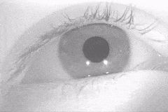
Image Captioning with RNNs and Attention
Attention idea: New context vector at every time step.
Each context vector will attend to different image regions
gif source
^{z}0,0 | ^{z}0,1 | ^{z}0,2
^{z}1,0 | ^{z}1,1 | ^{z}1,2
^{z}2,0 | ^{z}2,1 | ^{z}2,2
h₀
CNN
MLP
Attention Saccades in humans
Extract spatial features from a pretrained CNN
Features: H x W x D
Notes:
就好像人一样，当我们需要描述图片的时候，我们会一次看图片的一部分（也就是不同时间步的context表征不同），然后按一定的顺序描述内容

Slide 41
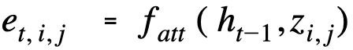
Image Captioning with RNNs and Attention
Alignment scores:
H x W
Compute alignments scores (scalars):
^{e}1,0,0 | ^{e}1,0,1 | ^{e}1,0,2
^{e}1,1,0 | ^{e}1,1,1 | ^{e}1,1,2
^{e}1,2,0 | ^{e}1,2,1 | ^{e}1,2,2
f (.) is an MLP
att
^{z}0,0 | ^{z}0,1 | ^{z}0,2
^{z}1,0 | ^{z}1,1 | ^{z}1,2
^{z}2,0 | ^{z}2,1 | ^{z}2,2
h₀
CNN
Extract spatial features from a pretrained CNN
Features: H x W x D
Notes:
仿照上面序列的做法，我们利用当前的表征h0给特征图中不同的区域赋予不同的分数，反映当前关注的region

Slide 42
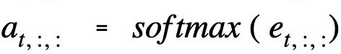
Image Captioning with RNNs and Attention
Alignment scores:
H x W
Attention: H x W
ª1,0,0 | ª1,0,1 | ª1,0,2
ª1,1,0 | ª1,1,1 | ª1,1,2
ª1,2,0 | ª1,2,1 | ª1,2,2
Normalize to get attention weights:
Compute alignments scores (scalars):
^{e}1,0,0 | ^{e}1,0,1 | ^{e}1,0,2
^{e}1,1,0 | ^{e}1,1,1 | ^{e}1,1,2
^{e}1,2,0 | ^{e}1,2,1 | ^{e}1,2,2
f (.) is an MLP
0 < a < 1,
att
t, i, j
attention values sum to 1
^{z}0,0 | ^{z}0,1 | ^{z}0,2
^{z}1,0 | ^{z}1,1 | ^{z}1,2
^{z}2,0 | ^{z}2,1 | ^{z}2,2
h₀
CNN
Extract spatial features from a pretrained CNN
Features: H x W x D
Notes:
Softmax将分数转换成权重

Slide 43
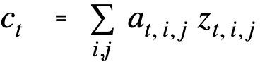
Image Captioning with RNNs and Attention
Alignment scores:
H x W
Attention:
H x W
Normalize to get attention weights:
Compute alignments scores (scalars):
Compute context vector:
^{e}1,0,0 | ^{e}1,0,1 | ^{e}1,0,2
^{e}1,1,0 | ^{e}1,1,1 | ^{e}1,1,2
^{e}1,2,0 | ^{e}1,2,1 | ^{e}1,2,2
ª1,0,0
ª1,0,1
ª1,0,2
f (.) is an MLP
ª1,1,0
ª1,1,1
ª1,1,2
0 < a < 1,
att
t, i, j
ª1,2,0
ª1,2,1
ª1,2,2
attention values sum to 1
^{z}0,0
^{z}0,1
^{z}0,2
h₀
CNN
^{z}1,0
^{z}1,1
^{z}1,2
^{z}2,0
^{z}2,1
^{z}2,2
Extract spatial features from a pretrained CNN
Features: H x W x D
c₁
X
Notes:
然后得到相应的context

Slide 44
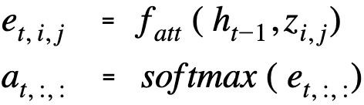
Image Captioning with RNNs and Attention
Each timestep of decoder uses a different context vector that looks at different parts of the input image.
Decoder: y_{t} = g_{V}(y_{t-1}, h_{t-1}, c_{t})
New context vector at every time step
person
y₁
^{z}0,0
^{z}0,1
^{z}0,2
h₀
h₁
CNN
^{z}1,0
^{z}1,1
^{z}1,2
^{z}2,0
^{z}2,1
^{z}2,2
Extract spatial features from a pretrained CNN
Features: H x W x D
c₁
y₀
Notes:
这里就可以仿照序列翻译的做法，每次看向输入的一个部分，然后得到一个输出（描述）

Slide 45
Image Captioning with RNNs and Attention
Alignment scores:
H x W
Attention:
H x W
Decoder: y_{t} = g_{V}(y_{t-1}, h_{t-1}, c_{t})
New context vector at every time step
^{e}1,0,0 | ^{e}1,0,1 | ^{e}1,0,2
^{e}1,1,0 | ^{e}1,1,1 | ^{e}1,1,2
^{e}1,2,0 | ^{e}1,2,1 | ^{e}1,2,2
ª1,0,0
ª1,0,1
ª1,0,2
ª1,1,0
ª1,1,1
ª1,1,2
person
ª1,2,0
ª1,2,1
ª1,2,2
y₁
^{z}0,0
^{z}0,1
^{z}0,2
h₀
h₁
CNN
^{z}1,0
^{z}1,1
^{z}1,2
^{z}2,0
^{z}2,1
^{z}2,2
Extract spatial features from a pretrained CNN
Features: H x W x D
c₁
y₀
c₂
X

Slide 46
Image Captioning with RNNs and Attention
Each timestep of decoder uses a different context vector that looks at different parts of the input image.
Decoder: y_{t} = g_{V}(y_{t-1}, h_{t-1}, c_{t})
New context vector at every time step
person
wearing
y₁
y₂
^{z}0,0
^{z}0,1
^{z}0,2
h₀
h₁
h₂
CNN
^{z}1,0
^{z}1,1
^{z}1,2
^{z}2,0
^{z}2,1
^{z}2,2
Extract spatial features from a
Features: H x W x D
c₁
y₀
c₂
y₁
pretrained CNN
[START]
Lecture 11 -
person
46
Fei-Fei Li, Jiajun Wu, Ruohan Gao

Slide 47
Image Captioning with RNNs and Attention
Each timestep of decoder uses a different context vector that looks at different parts of the input image.
Decoder: y_{t} = g_{V}(y_{t-1}, h_{t-1}, c_{t})
New context vector at every time step
person
wearing
hat
y₁
y₂
y₃
^{z}0,0
^{z}0,1
^{z}0,2
h₀
h₁
h₂
h₃
CNN
^{z}1,0
^{z}1,1
^{z}1,2
^{z}2,0
^{z}2,1
^{z}2,2
Extract spatial features from a
Features: H x W x D
c₁
y₀
c₂
y₁
y₂
c₃
pretrained CNN
wearing, 2022
[START] person
Lecture 11 - 41

Slide 48
Image Captioning with RNNs and Attention
Each timestep of decoder uses a different context vector that looks at different parts of the input image
Decoder: y_{t} = g_{V}(y_{t-1}, h_{t-1}, c_{t})
New context vector at every time step
person
wearing
hat
[END]
y₁
y₂
y₃
y₄
^{z}0,0
^{z}0,1
^{z}0,2
h₀
h₁
h₂
h₃
h₄
CNN
^{z}1,0
^{z}1,1
^{z}1,2
^{z}2,0
^{z}2,1
^{z}2,2
Extract spatial features from a pretrained CNN
Features: H x W x D
c₁
y₀
c₂
y₁
y₂
y₃
c₃
c₄
[START] person
Lecture 11 - 41
wearing hat
May 03, 2022

Slide 49
Image Captioning with RNNs and Attention
This entire process is differentiable.
- model chooses its own attention weights. No attention supervision is required.
Alignment scores:
H x W
Attention:
H x W
^{e}1,0,0 | ^{e}1,0,1 | ^{e}1,0,2
^{e}1,1,0 | ^{e}1,1,1 | ^{e}1,1,2
^{e}1,2,0 | ^{e}1,2,1 | ^{e}1,2,2
ª1,0,0
ª1,0,1
ª1,0,2
ª1,1,0
ª1,1,1
ª1,1,2
person wearing hat
y₁ y₂ y₃
[END]
ª1,2,0
ª1,2,1
ª1,2,2
y₄
^{z}0,0
^{z}0,1
^{z}0,2
h₀
h₁
h₂
h₃
h₄
CNN
^{z}1,0
^{z}1,1
^{z}1,2
^{z}2,0
^{z}2,1
^{z}2,2
Extract spatial features from a pretrained CNN
Features: H x W x D
c₁
y₀
c₂
y₁
y₂
y₃
c₃
c₄
X
[START] person
Lecture 11 - 42
wearing hat
May 03, 2022
Fei-Fei Li, Jiajun Wu, Ruohan Gao
Notes:
同样的，这个做法是可微的，attention的权重可以通过学习得到

Slide 50
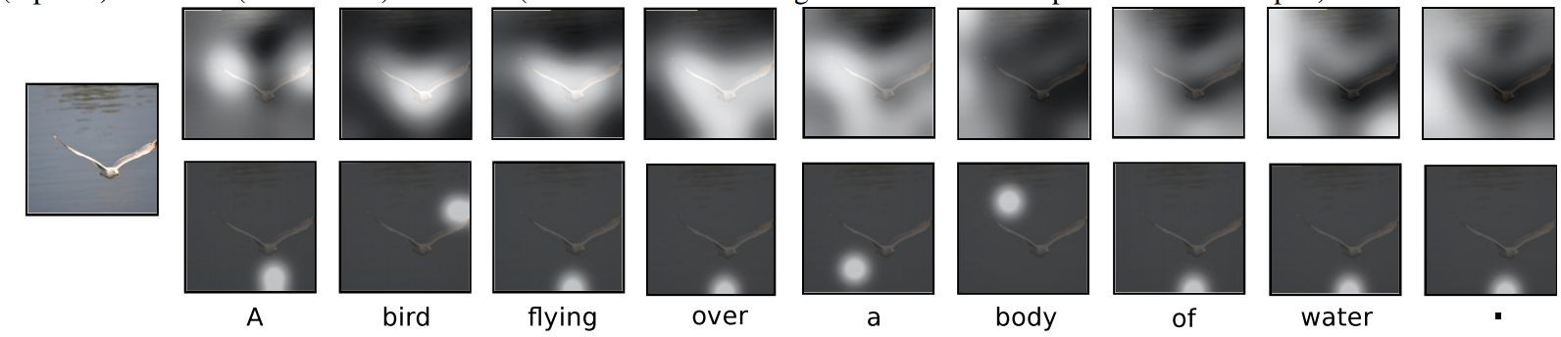
Image Captioning with Attention
Comparison
Soft attention
每个权重取值范围为[0,1]
Hard attention (requires reinforcement learning)
每个key的注意力只会取0或者1，也就是说我们只会令某几个特定的key有注意力，且权重均为1
Xu et al, “Show, Attend, and Tell: Neural Image Caption Generation with Visual Attention”, ICML 2015
Figure copyright Kelvin Xu, Jimmy Lei Ba, Jamie Kiros, Kyunghyun Cho, Aaron Courville, Ruslan Salakhutdinov, Richard S. Zemel, and Yoshua Benchio, 2015. Reproduced with permission.
Notes:
软注意力在pixel级，针对关注的细粒度信息，是可微的，常用于深度学习；
硬注意力在region级，关注潜在的判别区域，常采用采样的方式选取感兴趣输出（ROI），使得与loss之间的分布不可导，用于强化学习

Slide 51
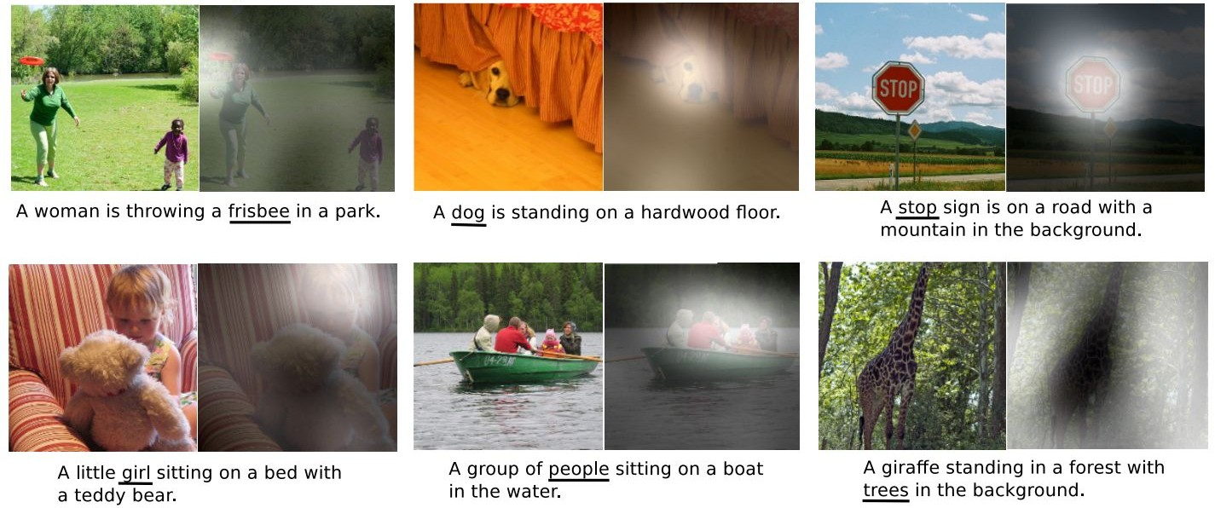
Image Captioning with Attention
Visualization
Xu et al, “Show, Attend, and Tell: Neural Image Caption Generation with Visual Attention”, ICML 2015
Figure copyright Kelvin Xu, Jimmy Lei Ba, Jamie Kiros, Kyunghyun Cho, Aaron Courville, Ruslan Salakhutdinov, Richard S. Zemel, and Yoshua Benchio, 2015. Reproduced with permission.
Notes:
可视化。可以看到输出word和关注的region确实是对应的。

Slide 52
Attention we just saw in image captioning
^{z}0,0 | ^{z}0,1 | ^{z}0,2
^{z}1,0 | ^{z}1,1 | ^{z}1,2
^{z}2,0 | ^{z}2,1 | ^{z}2,2
Features
Inputs:
Features: z (shape: H x W x D) Query: h (shape: D)
h
Notes:
再解释一下刚刚的attention
H就是对feature map的查询

Slide 53
Attention we just saw in image captioning
Operations:
Alignment: e_{i,j} = f_{att}(h, z_{i,j})
^{z}0,0 | ^{z}0,1 | ^{z}0,2
^{z}1,0 | ^{z}1,1 | ^{z}1,2
^{z}2,0 | ^{z}2,1 | ^{z}2,2
^{e}0,0 |  | ^{e}0,1 |  | ^{e}0,2
^{e}1,0 |  | ^{e}1,1 |  | ^{e}1,2
^{e}2,0 |  | ^{e}2,1 |  | ^{e}2,2
Features
Alignment
Inputs:
Features: z (shape: H x W x D) Query: h (shape: D)
h
Notes:
那么就由fatt（注意力函数）生成相应的评分
注意力函数有加性和点积等

Slide 54
Attention we just saw in image captioning
ª0,0 | ª0,1 |  | ª0,2
ª1,0 | ª1,1 |  | ª1,2
ª2,0 | ª2,1 |  | ª2,2
Attention
Operations:
Alignment: e_{i,j} = f_{att}(h, z_{i,j}) Attention: a = softmax(e)
softmax
^{z}0,0 | ^{z}0,1 | ^{z}0,2
^{z}1,0 | ^{z}1,1 | ^{z}1,2
^{z}2,0 | ^{z}2,1 | ^{z}2,2
^{e}0,0 |  | ^{e}0,1 |  | ^{e}0,2
^{e}1,0 |  | ^{e}1,1 |  | ^{e}1,2
^{e}2,0 |  | ^{e}2,1 |  | ^{e}2,2
Features
Alignment
Inputs:
Features: z (shape: H x W x D) Query: h (shape: D)
h
Notes:
然后softmax得到权重

Slide 55
Attention we just saw in image captioning
c
Outputs:
context vector: c (shape: D)
mul + add
ª0,0 | ª0,1 |  | ª0,2
ª1,0 | ª1,1 |  | ª1,2
ª2,0 | ª2,1 |  | ª2,2
Attention
Operations:
Alignment: e_{i,j} = f_{att}(h, z_{i,j}) Attention: a = softmax(e) Output: c = ∑_{i,j} a_{i,j}z_{i,j}
softmax
^{z}0,0 | ^{z}0,1 | ^{z}0,2
^{z}1,0 | ^{z}1,1 | ^{z}1,2
^{z}2,0 | ^{z}2,1 | ^{z}2,2
^{e}0,0 |  | ^{e}0,1 |  | ^{e}0,2
^{e}1,0 |  | ^{e}1,1 |  | ^{e}1,2
^{e}2,0 |  | ^{e}2,1 |  | ^{e}2,2
Features
Alignment
Inputs:
Features: z (shape: H x W x D) Query: h (shape: D)
h
Notes:
相乘再相加就得到了最终在该查询下的输出

Slide 56
General attention layer
c
Outputs:
context vector: c (shape: D)
mul + add
a₀
a₁
Attention
Operations:
Alignment: e_{i} = f_{att}(h, x_{i}) Attention: a = softmax(e) Output: c = ∑_{i} a_{i} x_{i}
a₂
softmax
Input vectors
x₀
e₀
Attention operation is permutation invariant.
Alignment
x₁
e₁
x₂
e₂
Doesn't care about ordering of the features
Stretch H x W = N into N vectors
Inputs:
Input vectors: x (shape: N x D) Query: h (shape: D)
h
Notes:
这里介绍了一个通常的注意力层是怎么做的。
因为注意力感受野是全局的，顺序并不影响结果，因此更为一般的，输入为一组向量时，就可以得到如上简化

Slide 57
General attention layer
c
Outputs:
context vector: c (shape: D)
mul + add
a₀
Attention
Operations:
Change f_{att}(.) to a simple dot product
- only works well with key & value transformation trick (will mention in a few slides)
a₁
a₂
Alignment: e_{i} = h ᐧ x_{i}
Attention: a = softmax(e) Output: c = ∑_{i} a_{i} x_{i}
softmax
Input vectors
x₀
e₀
Alignment
x₁
e₁
x₂
e₂
Inputs:
Input vectors: x (shape: N x D) Query: h (shape: D)
h
Notes:
由此就可以使用点积注意力函数来简化计算，不过只能用于键值查找的情况
使用点积可以得到计算效率更高的atten评分函数， 但是点积操作要求查询和键具有相同的长度d

Slide 58
General attention layer
对product值进行缩放
因为向量维度d越大，product值倾向越大，softmax后的值很大，导致梯度很小，更新慢
Scaled Dot Product
c
Outputs:
context vector: c (shape: D)
Change f_{att}(.) to a scaled simple dot product
mul + add
- Larger dimensions means more
terms in the dot product sum.
a₀
a₁
Attention
Operations:
So, the variance of the logits is higher.
Large magnitude vectors will produce much higher logits.
So, the post-softmax distribution has lower-entropy, assuming logits are IID.
Ultimately, these large magnitude vectors will cause softmax to peak and assign very little weight to all others
Divide by √D to reduce effect of large magnitude vectors
a₂
Alignment: e_{i} = h ᐧ x_{i} / √D
Attention: a = softmax(e) Output: c = ∑_{i} a_{i} x_{i}
softmax
Input vectors
x₀
e₀
Alignment
x₁
e₁
x₂
e₂
Inputs:
Input vectors: x (shape: N x D) Query: h (shape: D)
h
Notes:
Scaled点积，由于向量很长时点积的结果会很大/小，从而导致结果方差较大，那么在softmax之后大部分的权重都趋于0，只有一个趋于1，这样更新的时候梯度就比较小，不利于网络的学习
假设查询和键的所有元素都是独立的随机变量， 并且都满足零均值和单位方差， 那么两个向量的点积的均值为0，方差为d。 为确保无论向量长度如何， 点积的方差在不考虑向量长度的情况下仍然是1， 我们再将点积除以根号d。

Slide 59
General attention layer
y₀
y₁ y₂
Multiple context vectors
Outputs:
- each query creates a new output context vector
mul(→) + add (↑)
context vectors: y (shape: D)
ª0,0
ª0,1
ª0,2
Operations:
Alignment: e_{i,j} = q_{j} ᐧ x_{i} / √D Attention: a = softmax(e) Output: y_{j} = ∑_{i} a_{i,j} x_{i}
ª1,1
ª1,2
Attention
ª1,0
ª2,0
ª2,1
ª2,2
softmax (↑)
Input vectors
x₀
^{e}0,0 | ^{e}0,1 | ^{e}0,2
^{e}1,0 | ^{e}1,1 | ^{e}1,2
^{e}2,0 | ^{e}2,1 | ^{e}2,2
Alignment
x₁
x₂
q₁ |  | q₂
Inputs:
q₀
Input vectors: x (shape: N x D) Queries: q (shape: M x D)
Multiple query vectors
Notes:
相似的，多个查询对应多个输出

Slide 60
General attention layer
y₀
y₁ y₂
Outputs:
mul(→) + add (↑)
context vectors: y (shape: D)
ª0,1
ª0,2
Operations:
Alignment: e_{i,j} = q_{j} ᐧ x_{i} / √D Attention: a = softmax(e) Output: y_{j} = ∑_{i} a_{i,j} x_{i}
Notice that the input vectors are used for both the alignment as well as the attention calculations.
ª0,0
Attention
ª1,0
ª1,1
ª1,2
ª2,0
ª2,1
ª2,2
- We can add more expressivity to the layer by adding a different FC layer before each of the two steps.
softmax (↑)
Input vectors
x₀
^{e}0,0 | ^{e}0,1 | ^{e}0,2
^{e}1,0 | ^{e}1,1 | ^{e}1,2
^{e}2,0 | ^{e}2,1 | ^{e}2,2
Alignment
x₁
x₂
q₁ |  | q₂
Inputs:
q₀
Input vectors: x (shape: N x D) Queries: q (shape: M x D)
Notes:
注意到一个固定的查询和输入得到分配评分然后加权组合输入得到输出这个操作。以点积为例，其实就是做了两次矩阵乘法，其实没有什么可以学的东西；加性注意力也只有一个权重，这样会导致表达性欠佳
因此可以加入一个线性投影MLP/FC将输入映射到不同的特征空间来学习其中的权重，得到不同的表达

Slide 61
General attention layer
Notice that the input vectors are used for both the alignment as well as the attention calculations.
v₀
v₁
Operations:
Key vectors: k = xW
v₂
k
- We can add more expressivity to the layer by adding a different FC layer before each of the two steps.
Value vectors: v = xW_{v}
Input vectors
x₀
k₀
x₁
k₁
x₂
k₂
q₁ |  | q₂
Inputs:
Input vectors: x (shape: N x D) Queries: q (shape: M x D_{k})
q₀
Notes:
分别在key和value加入不同的投影，得到不同特征空间的表达

Slide 62
General attention layer
y₀
y₁ y₂
Outputs:
context vectors: y (shape: D )
The input and output dimensions can now change depending on the key and value FC layers
mul(→) + add (↑)
v
v₀
ª0,0
ª0,1
ª0,2
v₁
ª1,1
ª1,2
Attention
ª1,0
Operations:
Key vectors: k = xW
Notice that the input vectors are used for both the alignment as well as the attention calculations.
v₂
ª2,0
ª2,1
ª2,2
k
Value vectors: v = xW_{v} Alignment: e_{i,j} = q_{j} ᐧ k_{i} / √D Attention: a = softmax(e) Output: y_{j} = ∑_{i} a_{i,j} v_{i}
softmax (↑)
- We can add more expressivity to the layer by adding a different FC layer before each of the two steps.
Input vectors
x₀
k₀
^{e}0,0 | ^{e}0,1 | ^{e}0,2
^{e}1,0 | ^{e}1,1 | ^{e}1,2
^{e}2,0 | ^{e}2,1 | ^{e}2,2
Alignment
x₁
k₁
x₂
k₂
q₁ |  | q₂
Inputs:
Input vectors: x (shape: N x D) Queries: q (shape: M x D_{k})
q₀
Notes:
因为加入了fc/MLP投影，因此可以调整input，output的特征维度

Slide 63
Self attention layer
y₀
y₁ y₂
Outputs:
context vectors: y (shape: D_{v})
Recall that the query vector was a function of the input vectors.
mul(→) + add (↑)
v₀
ª0,0
ª0,1
ª0,2
v₁
ª1,1
ª1,2
Attention
ª1,0
Operations:
Key vectors: k = xW_{k}
Encoder: h = f (z)
v₂
ª2,1
ª2,2
0 W
where z is spatial CNN features
ª2,0
Value vectors: v = xW
v
f (.) is an MLP
Alignment: e = q ᐧ k_{i} / √D
W
softmax (↑)
i,j j
Attention: a = softmax(e) Output: y_{j} = ∑_{i} a_{i,j} v_{i}
^{z}0,0 | ^{z}0,1 | ^{z}0,2
^{z}1,0 | ^{z}1,1 | ^{z}1,2 | MLP
^{z}2,0 | ^{z}2,1 | ^{z}2,2
h₀
Input vectors
x₀
k₀
^{e}0,0 | ^{e}0,1 | ^{e}0,2
^{e}1,0 | ^{e}1,1 | ^{e}1,2
^{e}2,0 | ^{e}2,1 | ^{e}2,2
CNN
Alignment
x₁
k₁
x₂
k₂
q₁ |  | q₂
Inputs:
Input vectors: x (shape: N x D) Queries: q (shape: M x D_{k})
q₀
Notes:
这里说查询是输入的函数，更精确地说，查询取决于输入。
从captioning的例子来看，查询h0是特征图的投影，特征图是输入图片的结果。也就是说不需要另外再输入一个查询，直接就可以从输入生成所需的查询。
于是就得到自注意力机制

Slide 64
Self attention layer
We can calculate the query vectors from the input vectors, therefore, defining a "self-attention" layer.
Instead, query vectors are calculated using a FC layer.
Operations:
Key vectors: k = xW_{k} Value vectors: v = xW_{v} Query vectors: q = xW_{q}
Alignment: e_{i,j} = q_{j} ᐧ k_{i} / √D
Input vectors
Attention: a = softmax(e) Output: y_{j} = ∑_{i} a_{i,j} v_{i}
x₀
x₁
x₂
Inputs:
Input vectors: x (shape: N x D)
q₀ q₁ q₂
No input query vectors anymore
Queries: q (shape: M x D_{k})
Notes:
一般的，可以直接从input通过fc投影得到query，从而不需要额外地输入query

Slide 65
Self attention layer
y₀
y₁ y₂
Outputs:
context vectors: y (shape: D_{v})
mul(→) + add (↑)
v₀
ª0,0
ª0,1
ª0,2
v₁
ª1,1
ª1,2
Attention
ª1,0
Operations:
Key vectors: k = xW_{k}
v₂
ª2,0
ª2,1
ª2,2
Value vectors: v = xW
v
Query vectors: q = xW_{q} Alignment: e_{i,j} = q_{j} ᐧ k_{i} / √D Attention: a = softmax(e) Output: y_{j} = ∑_{i} a_{i,j} v_{i}
softmax (↑)
Input vectors
x₀
k₀
^{e}0,0
^{e}0,1
^{e}0,2
Alignment
x₁
k₁
^{e}1,0
^{e}1,1
^{e}1,2
x₂
k₂
^{e}2,0
^{e}2,1
^{e}2,2
Inputs:
Input vectors: x (shape: N x D)
q₀
q₁ q₂
Notes:
于是就得到整体的自注意力结构

Slide 66
Self attention layer - attends over sets of inputs
y₀
y₁ y₂
Outputs:
context vectors: y (shape: D_{v})
mul(→) + add (↑)
v₀
ª0,0 ª0,1
ª0,2
Attention
y₀ y₁ y₂
v₁
ª1,0 ª1,1
Operations:
Key vectors: k = xW_{k}
ª1,2
v₂
ª2,0 ª2,1
self-attention
x₀ x₁ x₂
ª2,2
Value vectors: v = xW
v
Query vectors: q = xW_{q} Alignment: e_{i,j} = q_{j} ᐧ k_{i} / √D Attention: a = softmax(e) Output: y_{j} = ∑_{i} a_{i,j} v_{i}
softmax (↑)
Input vectors
x₀
k₀
^{e}0,0 ^{e}0,1
^{e}0,2
Alignment
x₁
k₁
^{e}1,0 ^{e}1,1
^{e}1,2
x₂
k₂
^{e}2,0 ^{e}2,1
^{e}2,2
Inputs:
Input vectors: x (shape: N x D)
q₀
q₁ q₂
Notes:
将自注意力模块封装起来，就得到注意力层

Slide 67
Self attention layer - attends over sets of inputs
Permutation equivariant
Self-attention layer doesn’t care about the orders of the inputs!
Problem: How can we encode ordered sequences like language or spatially ordered image features?
(模型对于每个单词没有任何位置/顺序感)
y₁ y₀ y₂
y₂ y₁ y₀
self-attention
x₂ x₁ x₀
y₀ y₁ y₂
self-attention
self-attention
x₀ x₁ x₂
x₁ x₀ x₂
Notes:
rnn在处理序列的时候，word是逐个输入的，自带了时序信息，因此顺序不是问题
自注意层的并行特性并不会在意不同顺序的输入，为了保留序列的顺序信息，应当对有序输入进行顺序/位置编码，让attention注意到位置关系
位置编码可以是绝对的或相对的位置信息

Slide 68
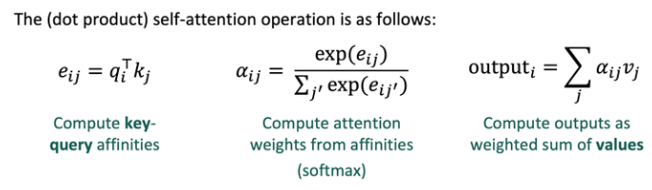
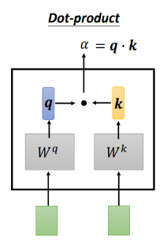
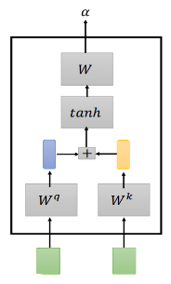
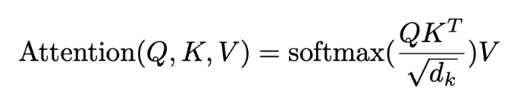
Self attention layer - attends over sets of inputs
Additive
在自注意力中，Q、K和V来自同一个源（Q=K=V）

Slide 69
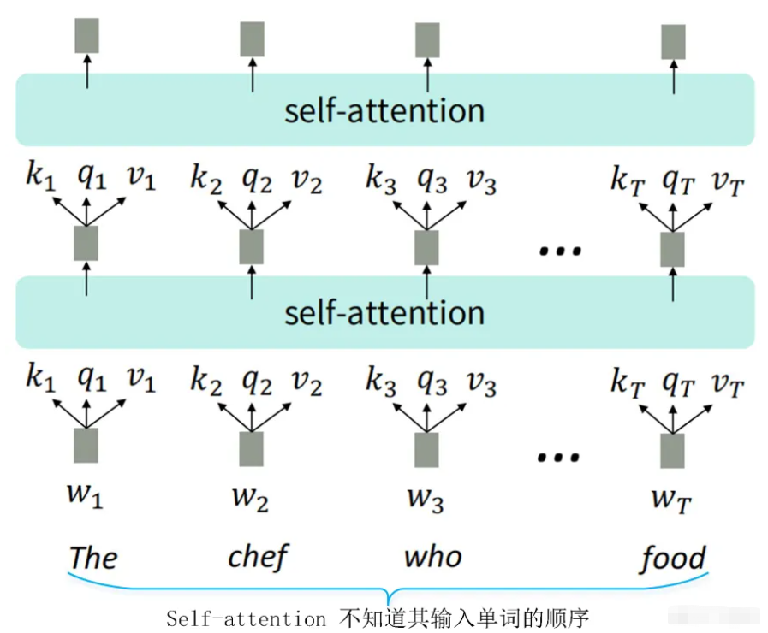
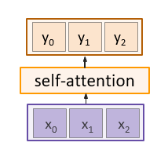
Positional encoding (PE)
由于 self-attention 不建立在顺序信息中，我们需要在键、查询和值中对句子的顺序进行编码
Notes:
位置编码设计的准则
它应该为每个时间的input输出唯一的编码（单词在句子中的位置），这很显然
任何两个时间步之间的距离在不同长度的句子中应该是一致的。这保证了两个word之间的距离度量是有意义的
我们的模型应该毫不费力地推广到更长的句子。其值应有界。这一点保证编码具有扩展性
对于一个固定位置它必须是确定的。

Slide 70
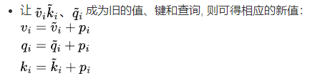
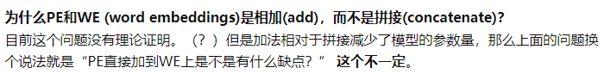
Positional encoding (PE)
我们要将此信息合并到我们的自注意力模块中：
y₀ y₁ y₂
self-attention
x₀ x₁ x₂
p₀ p₁ p₂
position encoding
x₀ x₁ x₂
Concatenate/add special positional encoding p_{j} to each input vector x_{j}
Notes:
位置编码设计的准则
它应该为每个时间的input输出唯一的编码（单词在句子中的位置），这很显然
任何两个时间步之间的距离在不同长度的句子中应该是一致的。这保证了两个word之间的距离度量是有意义的
我们的模型应该毫不费力地推广到更长的句子。其值应有界。这一点保证编码具有扩展性
对于一个固定位置它必须是确定的。

Slide 71
Positional encoding
Desiderata of pos(.) :
y₀ y₁ y₂
It should output a unique encoding for each time-step (word’s position in a sentence)
Distance between any two time-steps should be consistent across sentences with different lengths.
Our model should generalize to longer sentences without any efforts. Its values should be bounded.
It must be deterministic.
self-attention
x₀ x₁ x₂
p₀ p₁ p₂
position encoding
x₀ x₁ x₂
Concatenate/add special positional encoding p_{j} to each input vector x_{j}
We use a function pos: N →R^{d}
to process the position j of the vector into a d-dimensional vector
So, p_{j} = pos(j)
Notes:
位置编码设计的准则
它应该为每个时间的input输出唯一的编码（单词在句子中的位置），这很显然
任何两个时间步之间的距离在不同长度的句子中应该是一致的。这保证了两个word之间的距离度量是有意义的
我们的模型应该毫不费力地推广到更长的句子。其值应有界。这一点保证编码具有扩展性
对于一个固定位置它必须是确定的。
理想情况下PE的设计应该遵循这几个条件：
为每个时间步（单词在句子中的位置）输出唯一的编码；
即便句子长度不一，句子中两个时间步之间的距离应该是“恒定”的；
模型可以轻易泛化到更长的句子上；
PE必须是确定的。

Slide 72
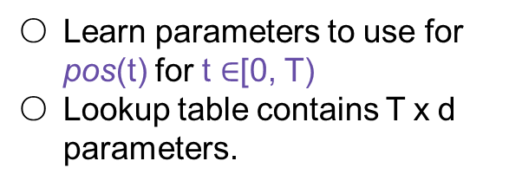
Positional encoding
Options for pos(.)
y₀ y₁ y₂
1. Learn a lookup table:
self-attention
Learn parameters to use for pos(t) for t $∈$[0, T)
Lookup table contains T x d parameters.
x₀ x₁ x₂
p₀ p₁ p₂
position encoding
x₀ x₁ x₂
Concatenate special positional encoding p_{j} to each input vector x_{j}
We use a function pos: N →R^{d} to process the position j of the
vector into a d-dimensional vector
Desiderata of pos(.) :
It should output a unique encoding for each time-step (word’s position in a sentence)
Distance between any two time-steps should be consistent across sentences with different lengths.
Our model should generalize to longer sentences without any efforts. Its values should be bounded.
It must be deterministic.
So, p_{j} = pos(j)
Fei-Fei Li, Jiajun Wu, Ruohan Gao
Notes:
一个想法是学习用一个d维向量来表示一个序数
比如说，简单的例子是计算机用一个32bit的二进制数来表示一个int数字，对照检查上面的准则，它无疑是满足的

Slide 73
Positional encoding
Options for pos(.)
y₀ y₁ y₂
1. Learn a lookup table:
self-attention
Learn parameters to use for pos(t) for t $∈$[0, T)
Lookup table contains T x d parameters.
x₀ x₁ x₂
p₀ p₁ p₂
position encoding
x₀ x₁ x₂
Concatenate special positional encoding p_{j} to each input vector x_{j}
We use a function pos: N →R^{d} to process the position j of the
vector into a d-dimensional vector
一般我们可能想到的方案是：
给每一个时间步设定[0,1]范围的一个值，0表示第一个，1表示最后一个。这样做的问题是，我们不确定句子里有多少个单词，不同单词数的句子中相邻单词之间的距离就不固定了。
给每一个时间步分配一个数值，例如第一个单词分配“1”，第二个单词分配“2”等等。这样做的问题是，这些值很大，并且实际中遇到的句子可能比训练时见过的句子还要长，这就会导致模型泛化性能变差。
So, p_{j} = pos(j)
Fei-Fei Li, Jiajun Wu, Ruohan Gao
Notes:
一个想法是学习用一个d维向量来表示一个序数
比如说，简单的例子是计算机用一个32bit的二进制数来表示一个int数字，对照检查上面的准则，它无疑是满足的

Slide 74
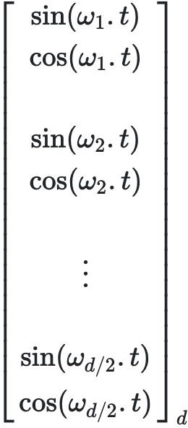
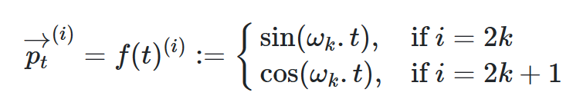
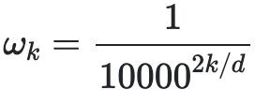
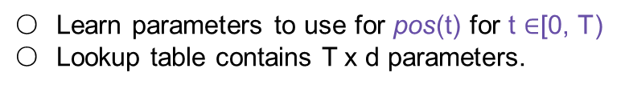
Positional encoding
y₀ y₁ y₂
Options for pos(.)
1. Learn a lookup table:
self-attention
Learn parameters to use for pos(t) for t $∈$[0, T)
Lookup table contains T x d parameters.
x₀ x₁ x₂
p₀ p₁ p₂
2. Design a fixed function with the desiderata
t是输入序列的一个位置，
是它对应的编码
position encoding
x₁ x₀ x₂
Concatenate special positional encoding p_{j} to each input vector x_{j}
We use a function pos: N →R^{d} to process the position j of the
vector into a d-dimensional vector
p(t) =
where
i 是向量的index
k的引入是为了区分奇偶
So, p_{j} = pos(j)
Fei-Fei Li, Jiajun Wu, Ruohan Gao
由函数定义，它的频率随着向量维度递减
Notes:
于是相应的，可以想到用三角函数来定义这样的编码，在维度上向量长度增长而频率在下降，在波长上形成了一个几何级数
这里有一个明显的疑问，为什么这样的cos sin编码可以表示一个位置？

Slide 75
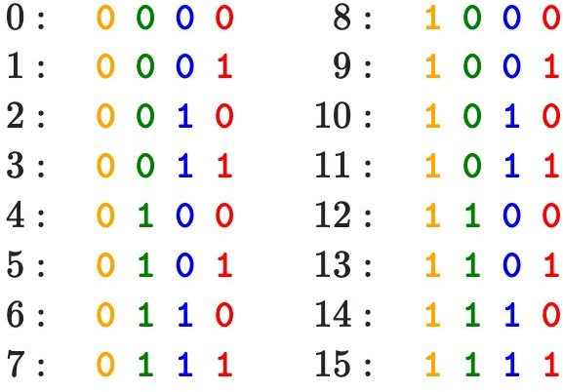
Positional encoding
假设现在我们用二进制来表示数字，可以观察到不同位置之间的变化率，最后一位在0和1上依次交替，第二低位在每两个数字上交替，以此类推。
y₀ y₁ y₂
self-attention
x₀ x₁ x₂
p₀ p₁ p₂
position encoding
x₀ x₁ x₂
Concatenate special positional encoding p_{j} to each input vector x_{j}
We use a function pos: N →R^{d} to process the position j of the
vector into a d-dimensional vector
但是用二进制表示数字在浮点数空间非常浪费空间，所以可以用它们的对应浮点函数 - 正弦函数。
p(t) =
where
Notes:
这里不妨先看二进制编码的例子
编码的直观性可以通过二进制编码来体现，不同位的编码在按一定的周期来回摆动，高位（黄色）编码的频率明显低于低位（红色），且频率随位数上升而下降。
这一点和三角函数的性质是一样的， 而使用二进制值在浮点数中会浪费空间。因此cos sin编码就是二进制编码在浮点数中的替代品

Slide 76
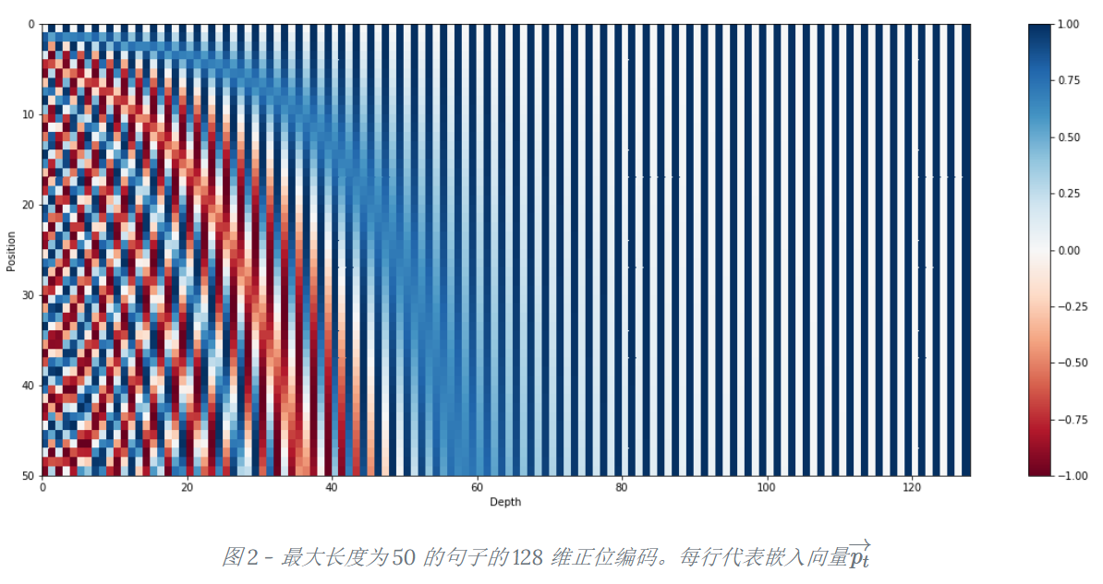
Positional encoding
y₀ y₁ y₂
Visualization
self-attention
x₀ x₁ x₂
p₀ p₁ p₂
position
position encoding
x₀ x₁ x₂
Concatenate special positional encoding p_{j} to each input vector x_{j}
We use a function pos: N →R^{d} to process the position j of the
vector into a d-dimensional vector
50
Depth
60
Notes:
这里插入一张可视化编码的示例图帮助理解
最大长度为50的句子其实只要大约长为60维的编码
下图展示了一个最多50个单词的句子中的每个单词的位置编码，维度是128。每一行都表示一个位置编码向量。对比上面的二进制数字表示，（每一个数字的二进制对应一个位置编码向量）：横向看，降低它们的频率，从红色的的位变为橙色的位；纵向来看，左侧上下变化较大，越向右上下变化差越小。所以实际上，正弦函数等效于二进制表示。

Slide 77
Positional encoding
y₀ y₁ y₂
self-attention
x₀ x₁ x₂
p₀ p₁ p₂
从参数维度上，使用三角函数Position Encoding不会引入额外参数，Learned Positional Embedding增加的参数量会随序列语句长度线性增长。
在可扩展性上，Learned Positional Embedding可扩展性较差，只能表征在max_seq_length以内的位置，而三角函数Position Encoding没有这样的限制，可扩展性更强
position encoding
x₀ x₁ x₂
Concatenate special positional encoding p_{j} to each input vector x_{j}
We use a function pos: N →R^{d} to process the position j of the
vector into a d-dimensional vector
Notes:
这里插入一张可视化编码的示例图帮助理解
最大长度为50的句子其实只要大约长为60维的编码
下图展示了一个最多50个单词的句子中的每个单词的位置编码，维度是128。每一行都表示一个位置编码向量。对比上面的二进制数字表示，（每一个数字的二进制对应一个位置编码向量）：横向看，降低它们的频率，从红色的的位变为橙色的位；纵向来看，左侧上下变化较大，越向右上下变化差越小。所以实际上，正弦函数等效于二进制表示。

Slide 78
Masked self-attention layer
y₀
y₁ y₂
Outputs:
context vectors: y (shape: D_{v})
mul(→) + add (↑)
对于包含时序的信息
v₀
ª0,0
ª0,1 |  | ª0,2
ª1,1 |  | ª1,2
Attention
Prevent vectors from looking at future vectors.
Manually set alignment scores to -infinity
v₁
0
Operations:
Key vectors: k = xW_{k}
v₂
0
0
ª2,2
Value vectors: v = xW
v
softmax (↑)
Query vectors: q = xW_{q} Alignment: e_{i,j} = q_{j} ᐧ k_{i} / √D Attention: a = softmax(e) Output: y_{j} = ∑_{i} a_{i,j} v_{i}
Input vectors
x₀
k₀
^{e}0,0
^{e}0,1
^{e}0,2
Alignment
x₁
k₁
-∞
^{e}1,1
^{e}1,2
x₂
k₂
-∞
-∞
^{e}2,2
Inputs:
Input vectors: x (shape: N x D)
q₀
q₁ q₂
Notes:
前面讲到rnn是按次序一个个输入input的，而attention一次就可以看到全部的input，对于包含时序的信息，这是不希望发生的
对于在t时间的qt，在计算的时候，我们希望他只能看到从0 - t-1时间的输入，而不应该看到后面的。但是attention机制的会一次计算得到所有的评分，因此需要在softmax输出权重之前把t时刻后面的评分都mask掉，具体做法就是让他们为一个很小的负数，这样在softmax之后权重就是0，也就实现了不看后面的。

Slide 79
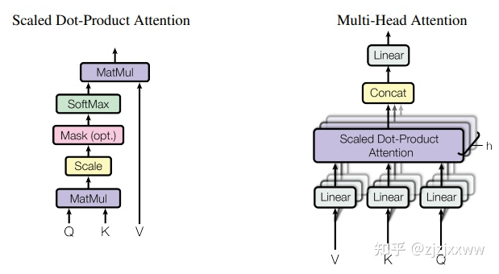
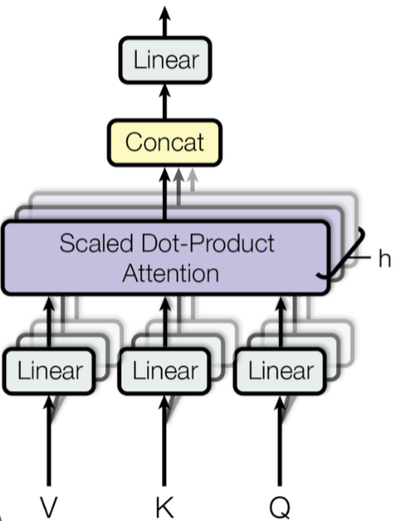
Multi-head self attention layer
- Multiple self-attention heads in parallel
多头自注意力，将模型分为多个头，形成多个子空间，可以让模型去关注不同方面的信息
y₀
y₁ y₂
Concatenate
head₀
head₁
head_{H-1}
y₀
y₁ y₂
y₀
y₁ y₂
y₀
y₁ y₂
Self-attention
Self-attention
...
Self-attention
x₀ x₁
x₂
x₀ x₁
x₂
x₀ x₁
x₂
Split
x₀ x₁
x₂
Notes:
多头自注意力，将模型分为多个头，形成多个子空间，可以让模型去关注不同方面的信息
具体来说就是把输入用fc投影到低维，然后分别做自注意力，再把输出concat到一起，经过fc得到最终的输出
每个投影都包含相应可以学习的w，关注最终输出序列中一个子空间，使得网络能够对输入实现不同的投影，抽取到更加丰富的特征信息，从而使得模型能够拟合不同的模式，产生我们需要的结果
相当于尝试n次，以期找到我们需要的结果

Slide 80
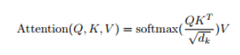
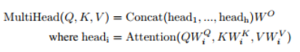
Multi-head self attention layer
- Multiple self-attention heads in parallel
多头自注意力，将模型分为多个头，形成多个子空间，可以让模型去关注不同方面的信息
Notes:
多头自注意力，将模型分为多个头，形成多个子空间，可以让模型去关注不同方面的信息
具体来说就是把输入用fc投影到低维，然后分别做自注意力，再把输出concat到一起，经过fc得到最终的输出
每个投影都包含相应可以学习的w，关注最终输出序列中一个子空间，使得网络能够对输入实现不同的投影，抽取到更加丰富的特征信息，从而使得模型能够拟合不同的模式，产生我们需要的结果
相当于尝试n次，以期找到我们需要的结果

Slide 81
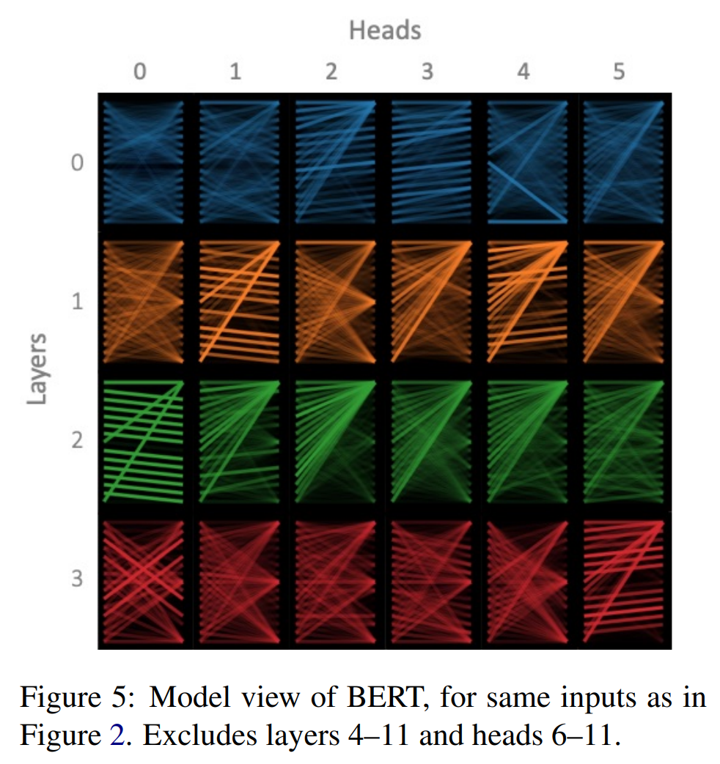
Multi-head self attention layer
- visualization
经过学习能产生不同的模式（不同的头关注的方面不一样），
但同一层中的多数头的关注模式是相似的（比如第3层的1234头）；
但是又总有那么一两个头与众不同（比如第2层的0头）。
Vig, Jesse. “A Multiscale Visualization of Attention in the Transformer Model.” ArXiv abs/1906.05714 (2019): n. pag.
Notes:
这里我补充一个多头可视化的结果slide
linear同样的随机初始化方式，经过学习却能产生不同的模式（不同的头关注的方面不一样），但同一层中的多数头的关注模式是相似的（比如第3层的1234头）；但是又总有那么一两个头与众不同（比如第2层的0头）。
这里我的理解是可以看作是模型在输入上做不同的尝试，相当于提供了一些备选的解决方案，然后做一个ensembling，从而更加robust，相似的大多数可能意味着一些显著的容易学习的模式

Slide 82
General attention versus self-attention
y₀ y₁ y₂
y₀ y₁ y₂
attention
self-attention
k₀ k₁ k₂ |  |  | v₀ v₁ v₂ |  |  | q₀ q₁ q₂
q₀ q₁ q₂
v₀ v₁ v₂
x₀ x₁ x₂
Notes:
两种注意力机制的对比
自注意力需要的输入更少，更方便应用

Slide 83

Example: CNN with Self-Attention
Input Image
CNN
Features:
C x H x W
Cat image is free to use under the Pixabay License
Notes:
以cnn举个例子，看自注意力在cnn中是怎么操作的
具体操作跟seq一样，只是把表征换成了feature maps

Slide 84
Example: CNN with Self-Attention
Queries: C’ x H x W
Input Image
1x1 Conv
Keys:
C’ x H x W
CNN
Features:
C x H x W
1x1 Conv
Cat image is free to use under the Pixabay License
Values:
C’ x H x W
1x1 Conv
Notes:
用不同的1*1conv得到不同的kqv

Slide 85
Example: CNN with Self-Attention
Queries: C’ x H x W
Attention Weights
(H x W) x (H x W)
Transpose
Input Image
1x1 Conv
softmax
x
Keys:
C’ x H x W
CNN
Features:
C x H x W
1x1 Conv
Cat image is free to use under the Pixabay License
Values:
C’ x H x W
1x1 Conv
Notes:
然后kq相乘得到自注意力权重

Slide 86
Example: CNN with Self-Attention
Queries: C’ x H x W
Attention Weights
(H x W) x (H x W)
Transpose
Input Image
1x1 Conv
softmax
x
Keys:
C’ x H x W
CNN
Features: C x H x W
1x1 Conv
Cat image is free to use under the Pixabay License
C’ x H x W
Values:
C’ x H x W
x
1x1 Conv
Notes:
再对v加权

Slide 87
Example: CNN with Self-Attention
Queries: C’ x H x W
Attention Weights
(H x W) x (H x W)
Transpose
Input Image
1x1 Conv
softmax
x
C x H x H
Keys:
C’ x H x W
CNN
Features:
C x H x W
1x1 Conv
Cat image is free to use under the Pixabay License
C’ x H x W
Values:
C’ x H x W
x
1x1 Conv
1x1 Conv
Notes:
再用1*1conv投影回原来的维度

Slide 88
Example: CNN with Self-Attention
Residual Connection
Queries: C’ x H x W
Attention Weights
(H x W) x (H x W)
Transpose
Input Image
1x1 Conv
softmax
x
C x H x W
Keys:
C’ x H x W
CNN
+
Features:
C x H x W
1x1 Conv
Cat image is free to use under the Pixabay License
C’ x H x W
Values:
C’ x H x W
x
1x1 Conv
1x1 Conv
Self-Attention Module
Notes:
最后再加入一个残差连接

Slide 89
Comparing RNNs to Transformer
RNNs
(+) LSTMs work reasonably well for long sequences.
(-) Expects an ordered sequences of inputs.
(-) Sequential computation: subsequent hidden states can only be computed after the previous ones are done.
Transformer:
(+) Good at long sequences. Each attention calculation looks at all inputs.
(+) Can operate over unordered sets or ordered sequences with positional encodings.
(+) Parallel computation: All alignment and attention scores for all inputs can be done in parallel.
(-) Requires a lot of memory: N x M alignment and attention scalers need to be calculated and stored for a single self-attention head. (but GPUs are getting bigger and better)
Notes:
总结：
rnn主要在太长的序列上表现不佳，同时计算是串行的，效率比较低。
Trans并行计算，可以应对无序的输入，但是开销比较大

Slide 90
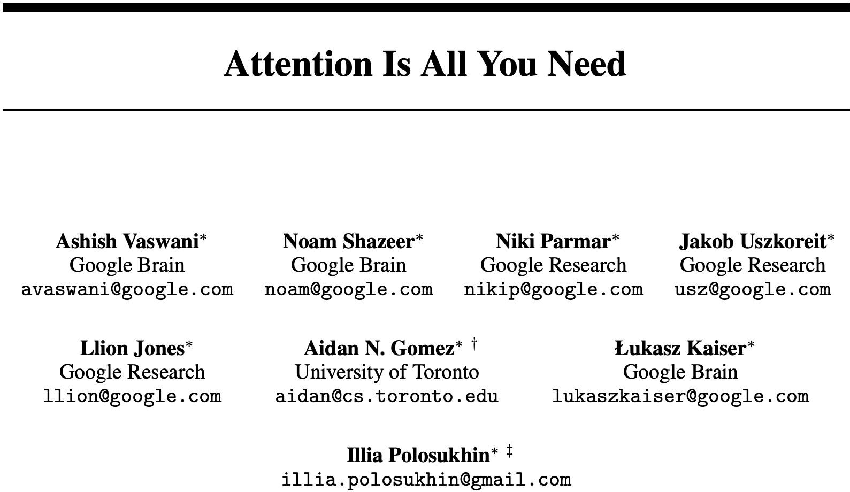
Transformer
“ImageNet Moment for Natural Language Processing”
Pretraining:
Download a lot of text from the internet
Train a giant Transformer model for language modeling
Finetuning:
Fine-tune the Transformer on your own NLP task
Notes:
在nlp中使用cv的迁移学习，先pretrain再finetune，从而更快地收敛并得到更好的结果
提出transformer的文章

Slide 91
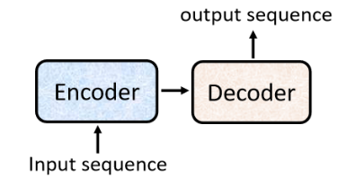
Transformer
Transformer模型是一个基于多头自注意力的序列到序列模型（seq2seq model），整个网络结构可以分为编码器（Encoder）和解码器（Decoder）两部分。
这个seq2seq模型输出序列的长度是不确定的。我们输入一个sequence后，先由Encoder负责处理，再把处理好的结果输入到Decoder中，由Decoder决定最后输出什么样的sequence。
Notes:
在nlp中使用cv的迁移学习，先pretrain再finetune，从而更快地收敛并得到更好的结果
提出transformer的文章

Slide 92
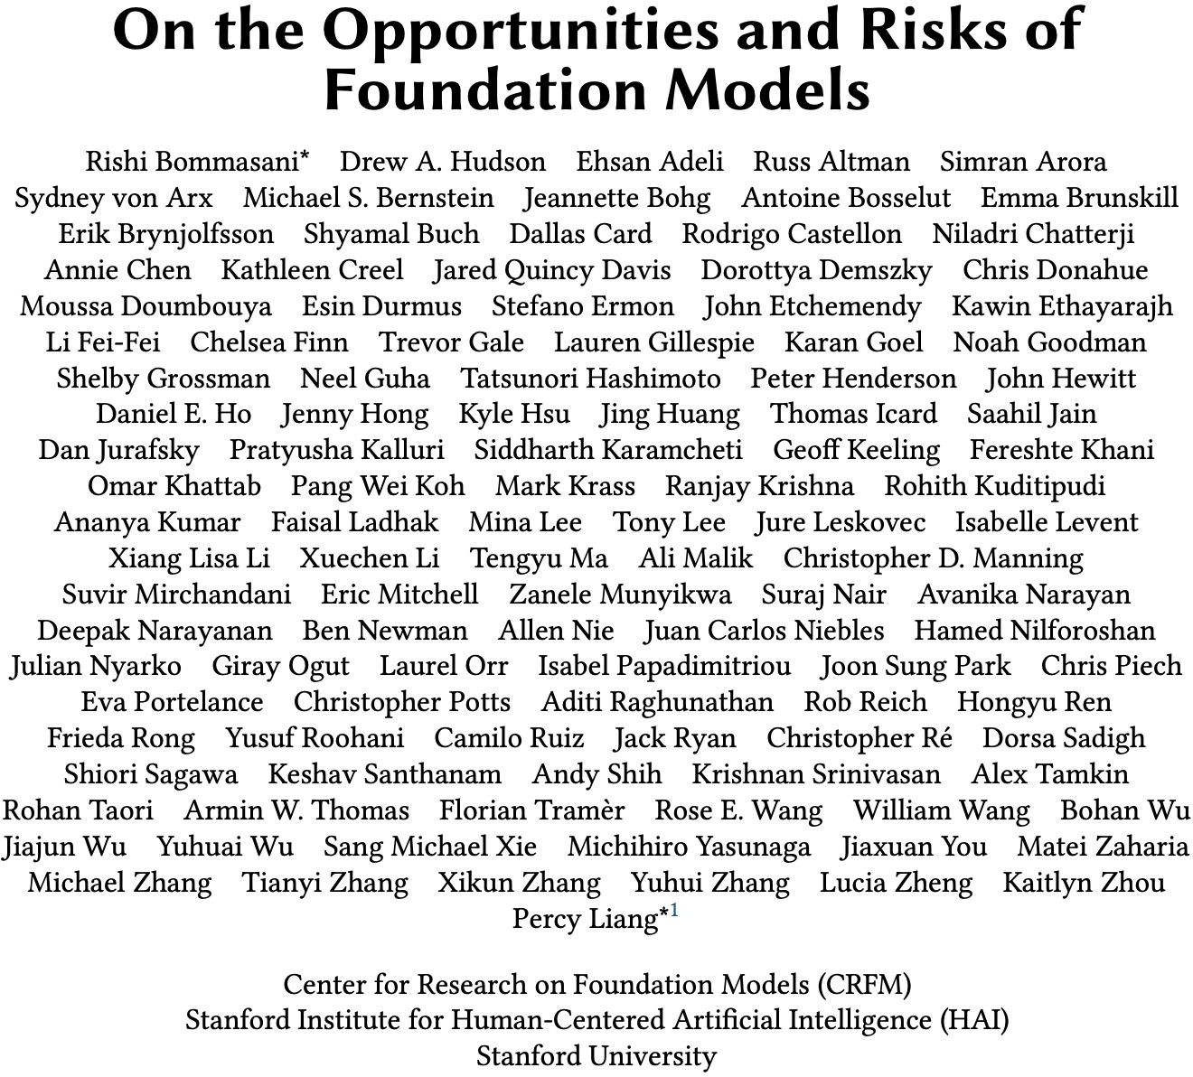
Notes:
这是一篇讨论基础模型的综述，文章介绍了基础模型的特性、能力、技术、应用以及社会影响等方面的内容，以此分析基于基础模型的人工智能研究和应用的发展现状及未来之路。
基础模型是任意的在大规模数据上训练并且可以适配(例如，微调)广泛下游任务的模型；当前的例子包括BERT[Devlin et al. 2019]、GPT-3 [Brown et al. 2020]和CLIP[Radford et al. 2021]。

Slide 93
Image Captioning using Transformers
Input: Image I
Output: Sequence y = y1 , y2,..., yT
^{z}0,0 | ^{z}0,1 | ^{z}0,2
^{z}1,0 | ^{z}1,1 | ^{z}1,2
^{z}2,0 | ^{z}2,1 | ^{z}2,2
CNN
Extract spatial features from a pretrained CNN
Features: H x W x D

Slide 94
Image Captioning using Transformers
Input: Image I
Output: Sequence y = y1 , y2,..., yT
Encoder: c = T (z)
W
where z is spatial CNN features
T_{W}(.) is the transformer encoder
^{z}0,0 | ^{z}0,1 | ^{z}0,2
^{z}1,0 | ^{z}1,1 | ^{z}1,2
^{z}2,0 | ^{z}2,1 | ^{z}2,2
^{c}0,0
^{c}0,1
...
^{c}0,2 ^{c}2,2
CNN
Transformer encoder
Extract spatial features from a pretrained CNN
Features: H x W x D
^{z}0,0
^{z}0,1
^{z}0,2
...
^{z}2,2
Notes:
Transformer 同样是encoder/decoder结构的，这里可以用来替代上文的rnn的位置，实现一样的功能
这里需要用到cnn来辅助提取特征，后续还会提到vit

Slide 95
Image Captioning using Transformers
Input: Image I
Output: Sequence y = y1 , y2,..., yT
Decoder: y_{t} = T_{D}(y_{0:t-1}, c)
where T_{D}(.) is the transformer decoder
Encoder: c = T (z)
person
wearing
hat [END]
W
where z is spatial CNN features
T_{W}(.) is the transformer encoder
y₁
y₂
y₃
y₄
^{z}0,0 | ^{z}0,1 | ^{z}0,2
^{z}1,0 | ^{z}1,1 | ^{z}1,2
^{z}2,0 | ^{z}2,1 | ^{z}2,2
^{c}0,0
^{c}0,1
...
^{c}0,2 ^{c}2,2
Transformer decoder
CNN
Transformer encoder
Extract spatial features from a pretrained CNN
Features: H x W x D
y₀
y₁
y₂
y₃
^{z}0,0
^{z}0,1
^{z}0,2
...
^{z}2,2
[START] person wearing hat

Slide 96
The Transformer encoder block
^{c}0,0
^{c}0,1
^{c}0,2
...
^{c}2,2
Transformer encoder
x N
Made up of N encoder blocks.
In vaswani et al. N = 6, D_{q}= 512
Transformer encoder
^{z}0,0
^{z}0,1
^{z}0,2
...
^{z}2,2
Notes:
Lets dive into it. :)
Encoder由n个block组成，在attention is all u need里面，输入向量的维度d是512，n为6

Slide 97
The Transformer encoder block
^{c}0,0
^{c}0,1
^{c}0,2
...
^{c}2,2
Transformer encoder
x N
Let's dive into one encoder block
^{z}0,0
^{z}0,1
^{z}0,2
...
^{z}2,2
x₀
x₁
x₂
x₂

Slide 98
The Transformer encoder block
^{c}0,0
^{c}0,1
^{c}0,2
...
^{c}2,2
Transformer encoder
x N
Positional encoding
Add positional encoding
^{z}0,0
^{z}0,1
^{z}0,2
...
^{z}2,2
x₀
x₁
x₂
x₂
Notes:
前面讲到自注意力机制是没有位置信息的，也就是说无论输入的序列是如何打乱的，计算的自注意力输出不会变，这对于序列翻译来说是不合理的
因此需要加入位置信息编码，这里直接使用add操作将位置编码和word加到一起

Slide 99
The Transformer encoder block
^{c}0,0
^{c}0,1
^{c}0,2
...
^{c}2,2
Transformer encoder
x N
Multi-head self-attention
Attention attends over all the vectors
Positional encoding
Add positional encoding
^{z}0,0
^{z}0,1
^{z}0,2
...
^{z}2,2
x₀
x₁
x₂
x₂
Notes:
然后就是多头的自注意力

Slide 100
The Transformer encoder block
^{c}0,0
^{c}0,1
^{c}0,2
...
^{c}2,2
Transformer encoder
x N
+
Residual connection
Multi-head self-attention
Attention attends over all the vectors
Positional encoding
Add positional encoding
^{z}0,0
^{z}0,1
^{z}0,2
...
^{z}2,2
x₀
x₁
x₂
x₂
Notes:
加上残差连接

Slide 101
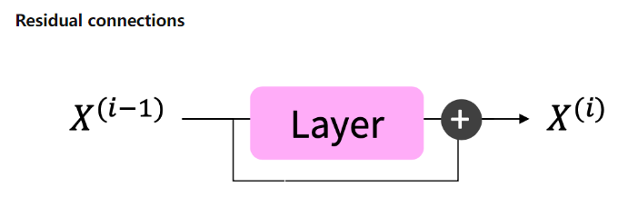
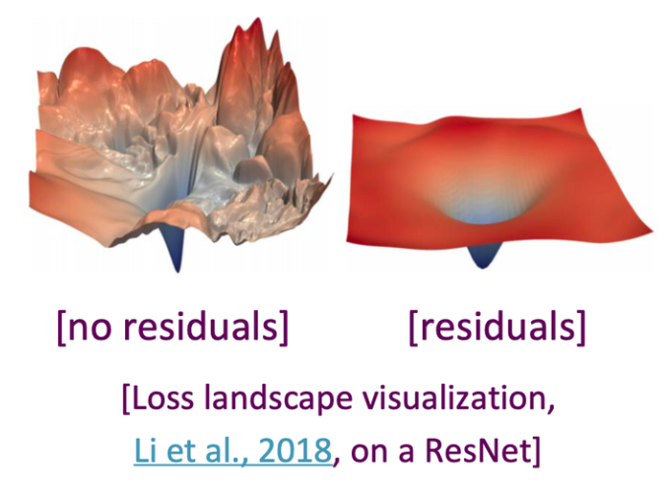
The Transformer encoder block
残差连接可以使得loss平面变得平滑，更容易训练
^{c}0,0
^{c}0,1
^{c}0,2
...
^{c}2,2
Transformer encoder
x N
+
Residual connection
Multi-head self-attention
Attention attends over all the vectors
Positional encoding
Add positional encoding
^{z}0,0
^{z}0,1
^{z}0,2
...
^{z}2,2
x₀
x₁
x₂
x₂
Notes:
加上残差连接

Slide 102

The Transformer encoder block
^{c}0,0
^{c}0,1
^{c}0,2
...
^{c}2,2
Transformer encoder
x N
Layer norm
LayerNorm over each vector individually
+
Residual connection
Multi-head self-attention
Attention attends over all the vectors
Positional encoding
Add positional encoding
^{z}0,0
^{z}0,1
^{z}0,2
...
^{z}2,2
x₀
x₁
x₂
x₂
Notes:
不知道前面的课程有没有讲到 layernorm，这里补充一张图帮助理解
Layernorm是因为不同的输入可能有不同的长度，在训练时，对BN来说需要保存每个step的统计信息（均值和方差），对所有的样本统计均值是无意义的，因为某些样本在后面的timestep时其实是padding值。在测试时，由于变长句子的特性，测试集可能出现比训练集更长的句子，所以对于后面位置的step，是没有训练的统计量使用的。
同时，由于不同句子的同一位置的分布大概率是不同的，所以应用BN来约束是没意义的。
因此改成对于每一个样本做标准化，即ln

Slide 103

The Transformer encoder block
^{c}0,0
^{c}0,1
^{c}0,2
...
^{c}2,2
Transformer encoder
x N
Layer norm
LayerNorm over each vector individually
+
Residual connection
Multi-head self-attention
Attention attends over all the vectors
Positional encoding
Add positional encoding
^{z}0,0
^{z}0,1
^{z}0,2
...
^{z}2,2
x₀
x₁
x₂
x₂
Layer normalization
它可以加快训练，normalizing gradients
通过归一化为每一层内的单位均值和标准差，减少隐藏矢量值的无信息变化
Notes:
不知道前面的课程有没有讲到 layernorm，这里补充一张图帮助理解
Layernorm是因为不同的输入可能有不同的长度，在训练时，对BN来说需要保存每个step的统计信息（均值和方差），对所有的样本统计均值是无意义的，因为某些样本在后面的timestep时其实是padding值。在测试时，由于变长句子的特性，测试集可能出现比训练集更长的句子，所以对于后面位置的step，是没有训练的统计量使用的。
同时，由于不同句子的同一位置的分布大概率是不同的，所以应用BN来约束是没意义的。
因此改成对于每一个样本做标准化，即ln

Slide 104
The Transformer encoder block
这个地方是一个简单的max(0, w1x+b1)w2+b2，先升维2048再降维512，倒置的bottleneck
^{c}0,0
^{c}0,1
^{c}0,2
...
^{c}2,2
Transformer encoder
x N
MLP
MLP over each vector individually
Layer norm
LayerNorm over each vector individually
+
Residual connection
Multi-head self-attention
Attention attends over all the vectors
Positional encoding
Add positional encoding
^{z}0,0
^{z}0,1
^{z}0,2
...
^{z}2,2
x₀
x₁
x₂
x₂
Notes:
这个地方是一个简单的max(0, w1x+b1)w2+b2，先升维2048再降维512，倒置的bottleneck

Slide 105
The Transformer encoder block
^{c}0,0
^{c}0,1
^{c}0,2
...
^{c}2,2
+
Residual connection
Transformer encoder
x N
MLP
MLP over each vector individually
Layer norm
LayerNorm over each vector individually
+
Residual connection
Multi-head self-attention
Attention attends over all the vectors
Positional encoding
Add positional encoding
^{z}0,0
^{z}0,1
^{z}0,2
...
^{z}2,2
x₀
x₁
x₂
x₂

Slide 106
The Transformer encoder block
y₀ y₁ y₂ y₃
^{c}0,0
^{c}0,1
^{c}0,2
...
^{c}2,2
Transformer Encoder Block:
Layer norm
Inputs: Set of vectors x Outputs: Set of vectors y
Transformer encoder
+
x N
MLP
Self-attention is the only interaction between vectors.
Layer norm
+
Layer norm and MLP operate independently per vector.
Multi-head self-attention
Highly scalable, highly
Positional encoding
parallelizable, but high memory usage.
^{z}0,0
^{z}0,1
^{z}0,2
...
^{z}2,2
x₀
x₁
x₂
x₂
Notes:
然后就得到encoder的输出，在此基础上重复n次操作（n个block）就得到输出

Slide 107
T... he Transformer Decoder block
person wearing hat [END]
y₀
y₁
y₂
y₃
Transformer decoder
Made up of N decoder blocks.
x N
^{c}0,0
In vaswani et al. N = 6, D_{q}= 512
^{c}0,1
^{c}0,2
...
^{c}2,2
Decoder基本参数和encoder一样
y₀
y₁
y₂
wearing
y₃
[START] person
hat
Vaswani et al, “Attention is all you need”, NeurIPS 2017
Notes:
Decoder基本参数和encoder一样

Slide 108
T... he Transformer Decoder block
y₀ y₁ y₂ y₃
FC
person wearing hat [END]
y₃
y₀
y₁
y₂
Transformer decoder
Let's dive into the transformer decoder block
^{c}0,0
x N
^{c}0,1
^{c}0,0
^{c}0,2
^{c}0,1
...
^{c}0,2
^{c}2,2
...
^{c}2,2
y₀
y₁
y₂
wearing
y₃
hat
[START] person
x₀
x₁
x₂
x₃
Vaswani et al, “Attention is all you need”, NeurIPS 2017

Slide 109
T... he Transformer Decoder block
y₀ y₁ y₂ y₃
FC
person wearing hat [END]
Layer norm
Most of the network is the same to transformer encoder.
y₃
+
y₀
y₁
y₂
MLP
Transformer decoder
Layer norm
+
^{c}0,0
x N
^{c}0,1
^{c}0,0
第一个自注意力层加上了mask，原因是在当前step的时候，不应该看到后面时间的输入，因此需要mask掉，保证做inference 的时候和train一致
c
0,2
Layer norm
^{c}0,1
...
+
^{c}0,2
^{c}2,2
Masked Multi-head self-attention
...
^{c}2,2
y₀
y₁
y₂
wearing
y₃
hat
Positional encoding
[START] person
x₀
x₁
x₂
x₃
Vaswani et al, “Attention is all you need”, NeurIPS 2017
Notes:
Decoder内部子层和encoder也一样，只是这里的第一个自注意力层加上了mask，原因是在当前step的时候，不应该看到后面时间的输入，因此需要mask掉，保证做inference 的时候和train一致

Slide 110




T... he Transformer Decoder block
y₀ y₁ y₂ y₃
FC
person wearing hat [END]
Layer norm
y₃
+
y₀
y₁
y₂
MLP
Transformer decoder
Layer norm
+
Multi-head attention block attends over the transformer encoder outputs.
^{c}0,0
x N
^{c}0,1
Multi-head attention
k v q
^{c}0,0
^{c}0,2
For image captions, this is how we inject image features into the decoder.
^{c}0,1
Layer norm
...
+
^{c}0,2
^{c}2,2
Masked Multi-head self-attention
...
^{c}2,2
y₀
y₁
y₂
y₃
Positional encoding
x₀ x₁ x₂ x₃
[START]
person wearing hat
Vaswani et al, “Attention is all you need”, NeurIPS 2017
Notes:
这里最大的区别在于第二个注意力层的key和value都来自encoder的输出（也就是对输入的编码，在rnn提到的context），而query由decoder上一个step的输出作为input产生，也就是通过query从encoder的输出里面挑出当前需要的东西

Slide 111
T... he Transformer Decoder block
y₀ y₁ y₂ y₃
FC
Transformer Decoder Block:
person wearing hat [END]
Layer norm
Inputs: Set of vectors x and Set of context vectors c.
Outputs: Set of vectors y.
y₃
+
y₀
y₁
y₂
MLP
Transformer decoder
Layer norm
Masked Self-attention only interacts with past inputs.
^{c}0,0
+
x N
^{c}0,1
Multi-head attention
k v q
Multi-head attention block is NOT self-attention. It attends over encoder outputs.
^{c}0,0
^{c}0,2
^{c}0,1
Layer norm
...
+
^{c}2,2
Highly scalable, highly parallelizable, but high memory usage.
^{c}0,2
Masked Multi-head self-attention
...
^{c}2,2
y₀
y₁
y₂
y₃
Positional encoding
x₀ x₁ x₂ x₃
[START]
person wearing hat
Vaswani et al, “Attention is all you need”, NeurIPS 2017
Notes:
这里重点说明第二个注意力层的输入来自不同的地方，不是自注意力，同时transformer的并行性很好，但是开销也很大

Slide 112

T... he Transformer Architecture
Decoder
Encoder
Vaswani et al, “Attention is all you need”, NeurIPS 2017
Notes:
附上论文贴图，回顾一下整体结构

Slide 113

Transformer
这里Decoder使用的是Encoder最后一层的输出，当然，也可以和中间的其他层做出各式各样的连接，如下图所示：

Slide 114
Image Captioning using Transformers
- No recurrence at all
person
wearing
hat [END]
y₁
y₂
y₃
y₄
^{z}0,0 | ^{z}0,1 | ^{z}0,2
^{z}1,0 | ^{z}1,1 | ^{z}1,2
^{z}2,0 | ^{z}2,1 | ^{z}2,2
^{c}0,0
^{c}0,1
^{c}0,2
...
^{c}2,2
Transformer decoder
CNN
Transformer encoder
Extract spatial features from a pretrained CNN
Features: H x W x D
y₀
y₁
y₂
y₃
^{z}0,0
^{z}0,1
^{z}0,2
...
^{z}2,2
[START] person wearing hat
Notes:
对比之前的做法，可以把上文图片描述任务的rnn换成transformer

Slide 115
Image Captioning using Transformers
-Perhaps we don't need convolutions at all?
person
wearing
hat [END]
y₁
y₂
y₃
y₄
^{z}0,0 | ^{z}0,1 | ^{z}0,2
^{z}1,0 | ^{z}1,1 | ^{z}1,2
^{z}2,0 | ^{z}2,1 | ^{z}2,2
^{c}0,0
^{c}0,1
^{c}0,2
...
^{c}2,2
Transformer decoder
CNN
Transformer encoder
Extract spatial features from a pretrained CNN
Features: H x W x D
y₀
y₁
y₂
y₃
^{z}0,0
^{z}0,1
^{z}0,2
...
^{z}2,2
[START] person wearing hat
Notes:
上面rnn之所以需要cnn提取特征，是因为rnn本身设计用来处理时序信息，缺乏对于空间信息的归纳偏置
那么能不能直接用nlp的模型做cv的任务呢？
Transformer本身基于注意力机制，输入是一个不考虑时序或者空间信息的集合，可以考虑把图片本身当成一个word向量来处理，但是这样对于大图片来说存在复杂度爆炸的问题
有做法是利用cnn得到特征图（如resnet 224*224 -> 14*14）从而减小复杂度，或者是做局部或轴注意力，又或是用一些点做稀疏注意力来近似全局注意力，那么有没有办法可以更简洁呢？

Slide 116









Image Captioning using ONLY transformers
-Transformers from pixels to language
person wearing
hat [END]
y₁
y₂
y₃
y₄
^{c}0,0
^{c}0,1
...
Transformer decoder
^{c}0,2 ^{c}2,2
Transformer encoder
y₀
y₁
y₂
y₃
...
把图片打成16*16的patch
[START] person wearing hat
为了对图片进行分类，类似于 BERT，ViT 也添加了 [class] token
Dosovitskiy et al, “An Image is Worth 16x16 Words: Transformers for Image Recognition at Scale”, ArXiv 2020 Colab link to an implementation of vision transformers
Notes:
为了解决直接把图片展开作为输入太大，复杂度太高的问题
在vit这篇里面直接把图片打成16*16的patch（经过fc）作为一个embedding输入，再加上patch所在的位置编码，其余处理与nlp一致。在分类上取得了与cnn同样甚至优于的结果，尤其是在大数据大模型上。
在遮挡、分布偏移、对抗patch和乱序排列等问题上都取得了很好的结果，证明了trans强大的性能和良好的可扩展性和稳健性，真正做到连通了cv和nlp

Slide 117

Vision Transformers vs. ResNets
在图片识别任务上，vit取得了普遍优于resnet的结果，在小模型上混合模型有更好的表现，但在大模型上vit的优势明显。
混合模型是指利用cnn提取的14*14特征图来作为输入（原始vit的输入也是14*14的序列）
Dosovitskiy et al, “An Image is Worth 16x16 Words: Transformers for Image Recognition at Scale”, ArXiv 2020 Colab link to an implementation of vision transformers
Notes:
在图片识别任务上，vit取得了普遍优于resnet的结果，在小模型上混合模型有更好的表现，但在大模型上vit的优势明显。
混合模型是指利用cnn提取的14*14特征图来作为输入（原始vit的输入也是14*14的序列）

Slide 118



Vision Transformers
Swin Transformer
Liu et al, “Swin Transformer: Hierarchical Vision Transformer using Shifted Windows”, ICCV 2021
Fan et al, “Multiscale Vision Transformers”, ICCV 2021
ICCV 2021 best paper
DETR
Carion et al, “End-to-End Object Detection with Transformers”, ECCV 2020
Notes:
Transformer在cv的应用
Multiscale ViT利用pooling加入了多尺度处理的思想，类似FPN，平衡了开销和表现，
swin trans经典文章，使用了层次化feature maps，解决了下游任务（分割检测）的多尺度问题；提出Shifted Windows，考虑到了相邻patch之间关系的同时极大降低了transformer的计算复杂度，
DETR是transformer用于目标检测的开山之作，提出新的出框方式，没有NMS ，anchor 等操作，整个由网络实现端到端的目标检测实现，大大简化了目标检测的pipeline

Slide 119

Vision Transformers
Swin Transformer
Liu et al, “Swin Transformer: Hierarchical Vision Transformer using Shifted Windows”, ICCV 2021
ICCV 2021 best paper
Notes:
Transformer在cv的应用
Multiscale ViT利用pooling加入了多尺度处理的思想，类似FPN，平衡了开销和表现，
swin trans经典文章，使用了层次化feature maps，解决了下游任务（分割检测）的多尺度问题；提出Shifted Windows，考虑到了相邻patch之间关系的同时极大降低了transformer的计算复杂度，
DETR是transformer用于目标检测的开山之作，提出新的出框方式，没有NMS ，anchor 等操作，整个由网络实现端到端的目标检测实现，大大简化了目标检测的pipeline

Slide 120

ConvNets strike back!
Notes:
在Transformer取得巨大成功之后，人们开始重新审视cnn的设计
Convnext的作者在仔细研究了一系列vit的设计以后，仿照vit中先进的架构和做法对传统的cnn做了重新的设计，辅助以大量的消融实验和识别任务结果证明了这种做法的有效性和可扩展性，重新为CNN扳回一局
ConvNeXt的设计
2.1 macro design（大的结构上的设计）
2.1.1 Changing stage compute ratio（改变每个stage的堆叠次数）
2.1.2 Changing stem to “Patchify”（stem为最初的下采样模块，改为与swin相似的patch卷积进行下采样）
2.2 ResNeXt（参考ResNeXt）
2.2.1 depth conv（普通卷积改为DW 卷积）
2.2.2 width（增加每个stage网络的深度）
2.3 inverted bottleneck 2.3.1 inverting dims（bottleneck由Resnet中两头粗中间细改为了类似Mobilenetv2中两头细中间粗的结构）
2.4 large kerner size（增加卷积核大小）
2.4.1 Moving up depthwise conv layer（将bottleneck中DW卷积模块上移）
2.4.2 Increasing the kernel size（增大DW卷积的卷积核大小）
2.5 various layer-wise micro designs（微小结构的设计）
2.5.1 Replacing ReLU with GELU（激活函数的改变）
2.5.2 Fewer activation functions（使用更少的激活函数，仅在DW卷积后的全连接层使用激活函数）​编辑
2.5.3 Fewer normalization layers（将BN替换为LN，并且只在DW卷积后使用LN）
2.5.4 Substituting BN with LN（将BN替换为LN）
2.5.5 Separate downsampling layers（将Resnet中在bottleneck中进行下采样改为使用单独的下采样层）

Slide 121


Notes:
Vit的复仇
在之前的vit论文中着重讨论了架构设计和可扩展性，并未针对cv任务做过多的优化，本文重新审视了监督训练过程，探讨了一系列训练策略（正则化、更换损失函数、数据增强、随机裁剪、训练时长、修复分辨率（低分辨率下训练，目标分辨率finetune））对于性能的影响，将ViT的效果提升到了和其它架构类似的水平，证明了vit的架构是可以提供足够性能的。
https://zhuanlan.zhihu.com/p/518289161

Slide 122
Summary
Adding attention to RNNs allows them to "attend" to different parts of the input at every time step
The general attention layer is a new type of layer that can be used to design new neural network architectures
Transformers are a type of layer that uses self-attention and layer norm.
It is highly scalable and highly parallelizable
Faster training, larger models, better performance across vision and language tasks
They are quickly replacing RNNs, LSTMs, and may(?) even replace convolutions.
Notes:
最后总结

Slide 123
Next time:
Video Understanding
Most of our slides have been borrowed from the courses of Stanford CS131 and CS231N, Thanks!

